Slide 1
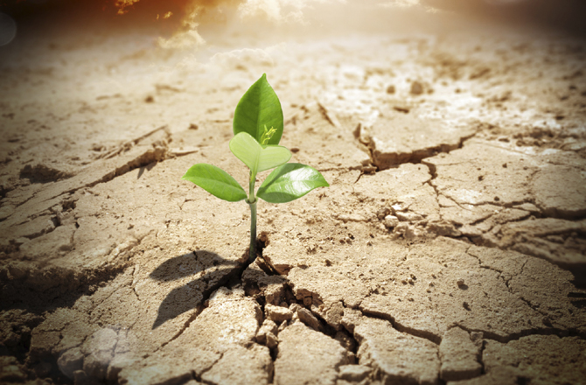
Be Hopeful
Zephaniah
Dr. Rick Griffith • Crossroads International Church Singapore
BibleStudyDownloads.org

Slide 2

Balance

Slide 3
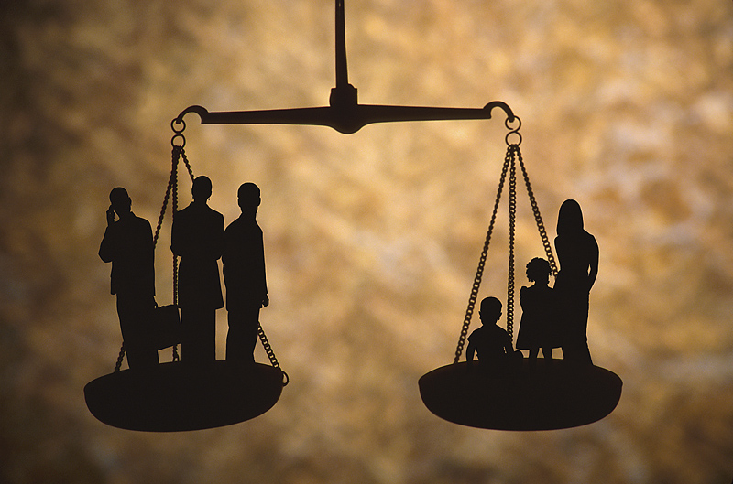
Work & Home Life Balance

Slide 4

Eating Balance

Slide 5
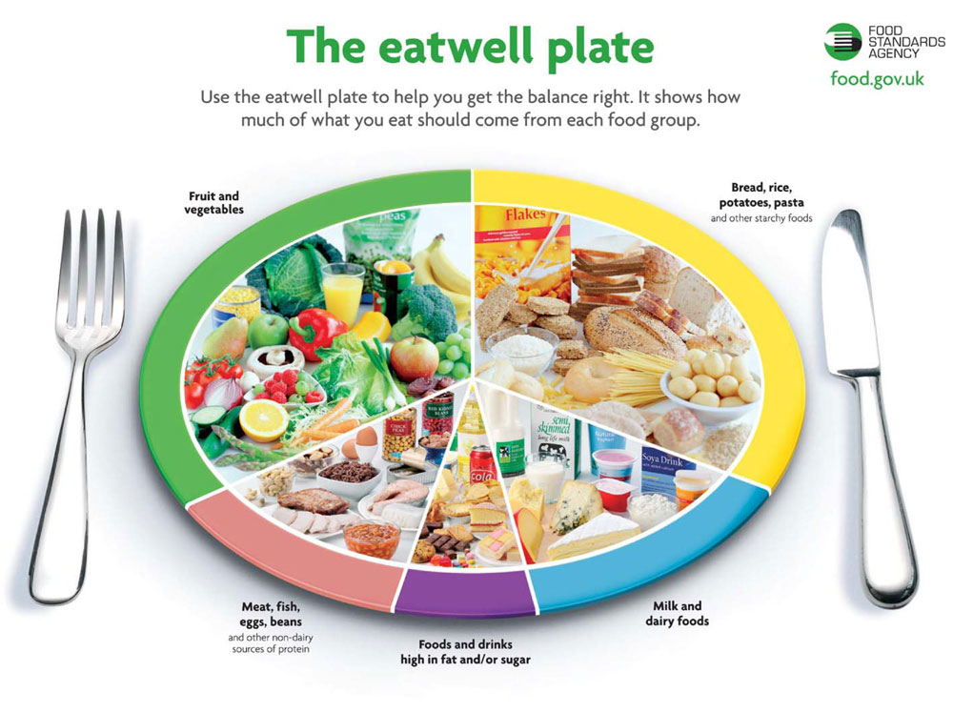
Balance

Slide 6

Balance

Slide 7

Balance

Slide 8
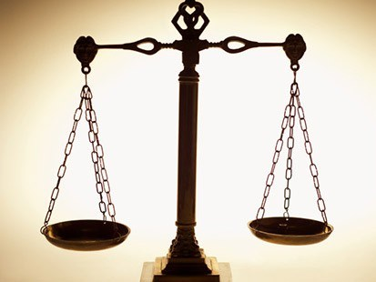
Is your view of God balanced?

Slide 9
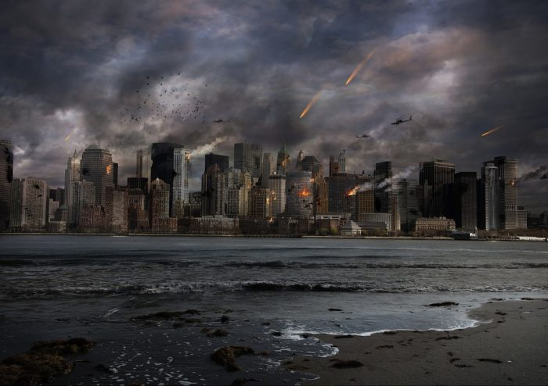
God is Judge

Slide 10
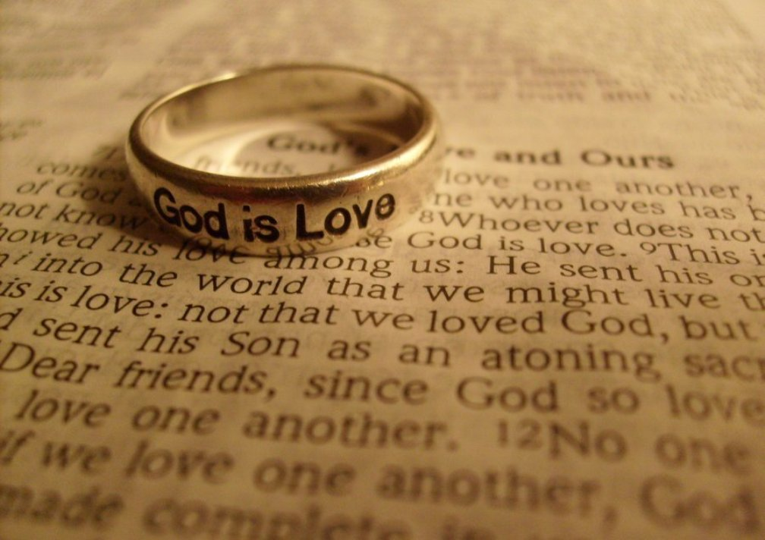
God is Love

Slide 11
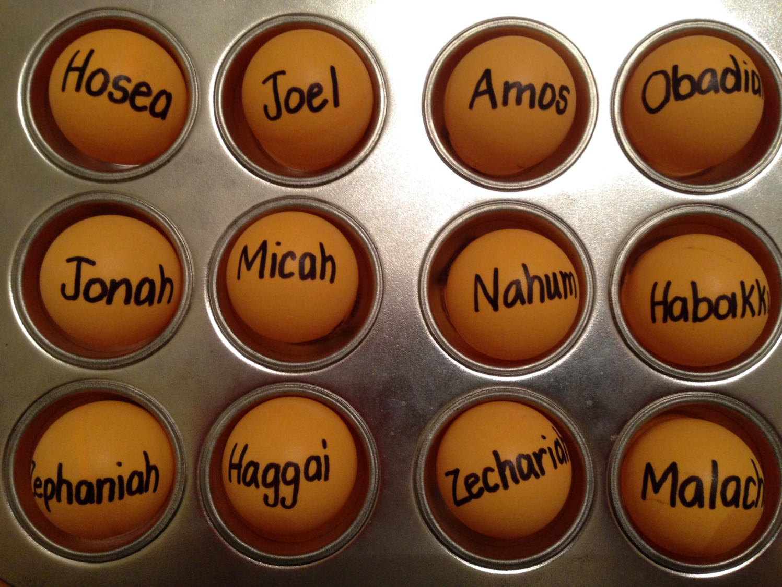
Be...
Loyal
Just
Humble
Caring
Generous
Patient
Hopeful

Slide 12
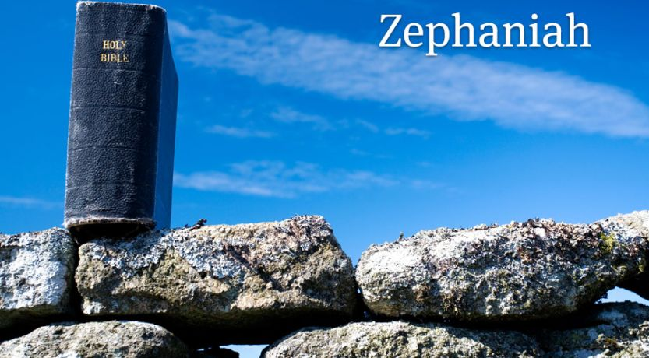
Zephaniah

Slide 13
Key Word
634
343
Day
Zephaniah

Slide 14
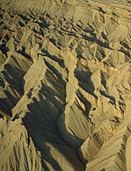
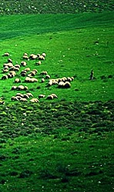
Zephaniah: Day of the LORD
634
Judgment | Salvation
1:1–3:8 | 3:9-20
Day of Punishment | Day of Praise
D-Day | V-Day
Destruction | Deliverance
Ruin | Restoration
God's Righteousness | God's Faithfulness
Warning | Encouragement
Earth 1:1-3 | Judah 1:4–2:3 | Nations 2:4-15 | Jerusalem 3:1-7 | Earth 3:8 |  | Remnant Regathered 3:9-10 | Redeemed & Restored 3:11-20
Judah, Nations, & the Whole Earth (about 630 BC)

Slide 15
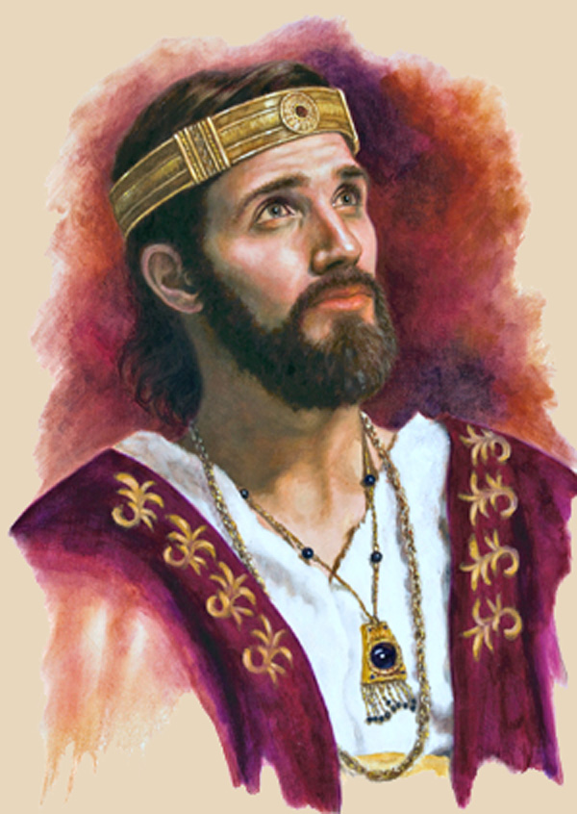
"The LORD gave this message to Zephaniah when Josiah son of Amon was king of Judah"
(Zephaniah 1:1a NLT).
Josiah

Slide 16
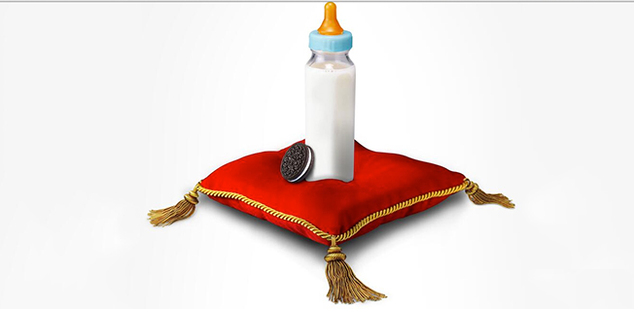
"The LORD gave this message to Zephaniah when Josiah son of Amon was king of Judah.
Zephaniah was the son of Cushi, son of Gedaliah, son of Amariah, son of Hezekiah"
(Zephaniah 1:1 NLT).

Slide 17
Zephaniah was of Royal Birth!
238
Hezekiah
King of Judah
(Line of David)
Sons who Did Not Rule
Sons who Ruled
Manasseh
Amariah
Amon
Gedaliah
Josiah
Cushi
Zephaniah
Righteous in white; Godless in yellow

Slide 18
Placing the Prophets
342
Key Dates
931
Obadiah
722
Jonah
Amos
Hosea
Isaiah
Micah
Nahum
Zephaniah
586

Slide 19
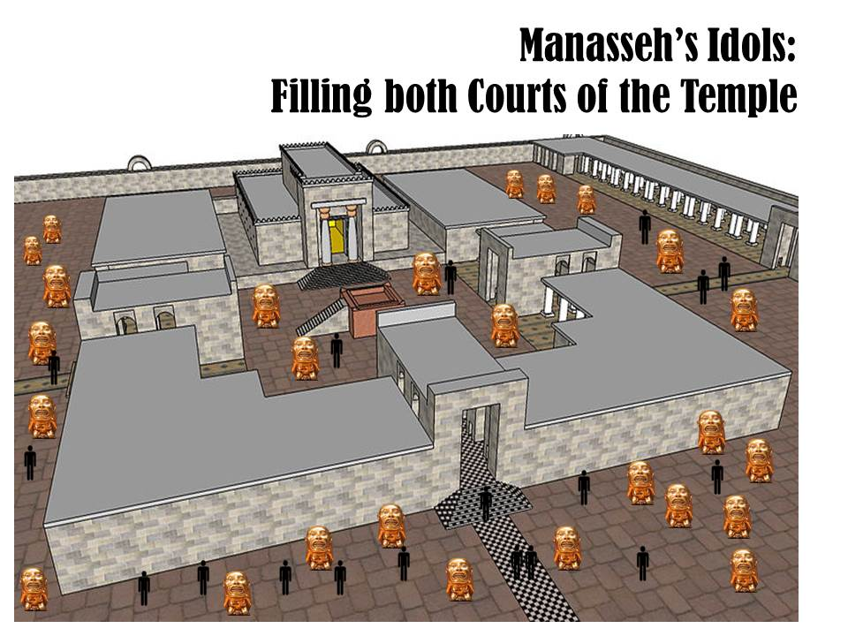
Zephaniah preached just after Manasseh filled both courts with idols

Slide 20
Jerusalem's Fall
Jerusalem's Fall
232
342
560
Key Dates
627
Jeremiah
605
Daniel
597
Ezekiel
586
538
Zephaniah
Joel
630
Lamentations
Habakkuk
590
606

Slide 21
How should we respond to the LORD’s balance?
Judgment
Deliverance
Repentance

Slide 22
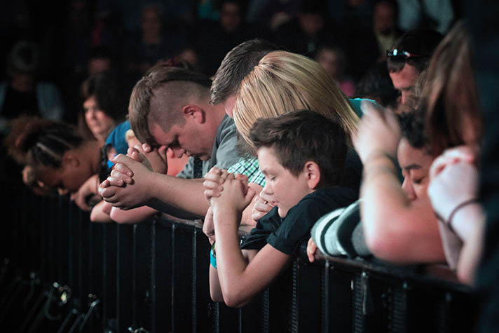
I. God’s future judgment warns us to repent.
Zephaniah 1:1–3:8
Notes:
The LORD will hold you accountable, so change your mind about him now.

Slide 23
Slides on
Zephaniah 1

Slide 24
Zephaniah: Day of the LORD
634
Judgment | Salvation
1:1–3:8 | 3:9-20
Day of Punishment | Day of Praise
D-Day | V-Day
Destruction | Deliverance
Ruin | Restoration
God's Righteousness | God's Faithfulness
Warning | Encouragement
Earth 1:1-3 | Judah 1:4–2:3 | Nations 2:4-15 | Jerusalem 3:1-7 | Earth 3:8 |  | Remnant Regathered 3:9-10 | Redeemed & Restored 3:11-20
Judah, Nations, & the Whole Earth (about 630 BC)

Slide 25
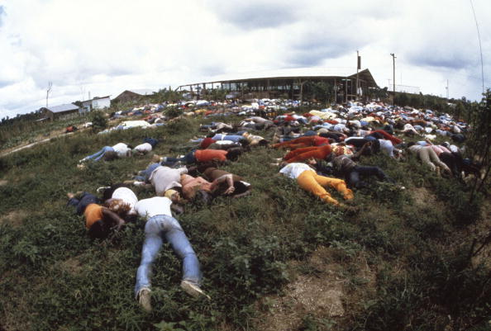
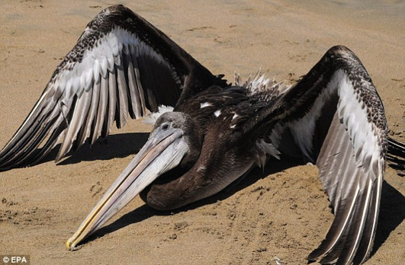
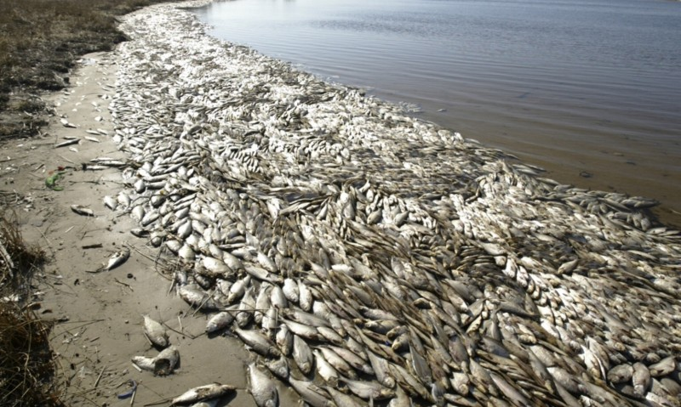
Judgment
"'I will sweep away everything from the face of the earth," says the LORD.
³"I will sweep away
people and animals alike.
I will sweep away the
birds of the sky and the
fish in the sea.
I will reduce the wicked to heaps of rubble, and I will wipe humanity from the face of the earth,' says the LORD" (Zeph. 1:2-3).

Slide 26

Woman
God's Creation…Day 6
"So God created man in his own image
in the image of God he created him
male and female he created them" (Gen. 1:27).

Slide 27
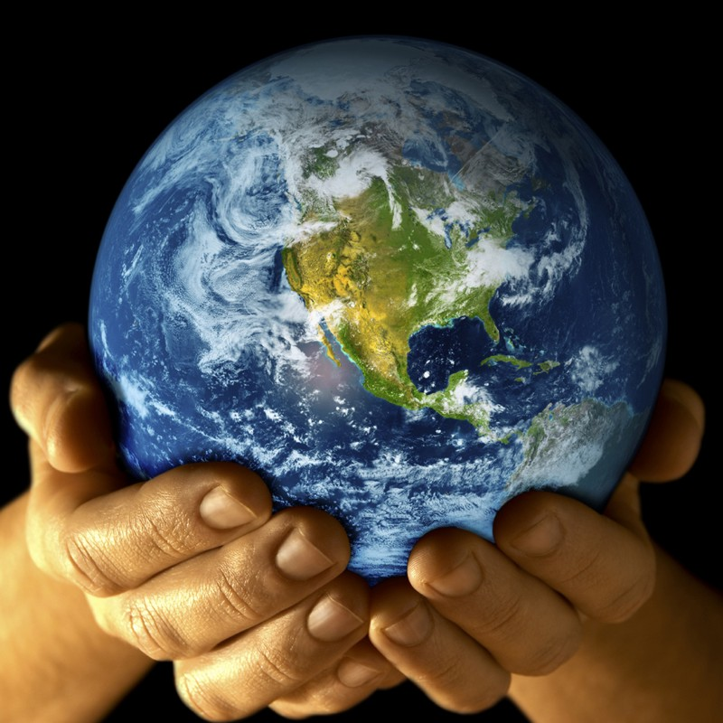
Mandate
448
and over the birds of the air
"And God blessed them, and God said to them, 'Be fruitful and multiply, and fill the earth and subdue it;
and have dominion over the fish of the sea
and over every living thing that
moves upon the earth'" (Gen. 1:28 NLT).

Slide 28
Judgment
"'I will sweep away everything from the face of the earth," says the LORD.
³"I will sweep away
people and animals alike.
I will sweep away the
birds of the sky and the
fish in the sea.
I will reduce the wicked to heaps of rubble, and I will wipe humanity from the face of the earth,' says the LORD" (Zeph. 1:2-3).

Slide 29
Zephaniah: Day of the LORD
634
Judgment | Salvation
1:1–3:8 | 3:9-20
Day of Punishment | Day of Praise
D-Day | V-Day
Destruction | Deliverance
Ruin | Restoration
God's Righteousness | God's Faithfulness
Warning | Encouragement
Earth 1:1-3 | Judah 1:4–2:3 | Nations 2:4-15 | Jerusalem 3:1-7 | Earth 3:8 |  | Remnant Regathered 3:9-10 | Redeemed & Restored 3:11-20
Judah, Nations, & the Whole Earth (about 630 BC)

Slide 30
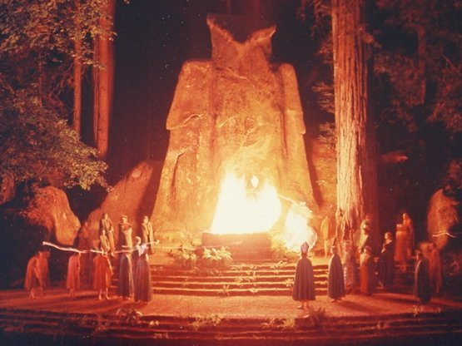
"I will crush Judah and Jerusalem with my fist and destroy every last trace of their Baal worship. I will put an end to all the idolatrous priests, so that even the memory of them will disappear'”
(Zephaniah 1:4 NLT).

Slide 31
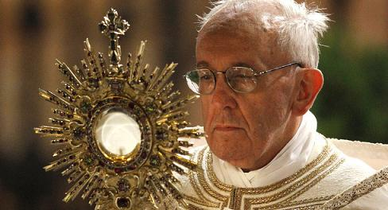
"For they go up to their roofs and bow down to the sun, moon, and stars. They claim to follow the LORD, but then they worship Molech, too'"
(Zephaniah 1:5 NLT).
Pope Francis worshipping the sun god

Slide 32
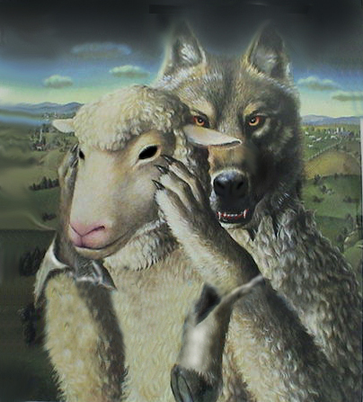
False Prophets

Slide 33
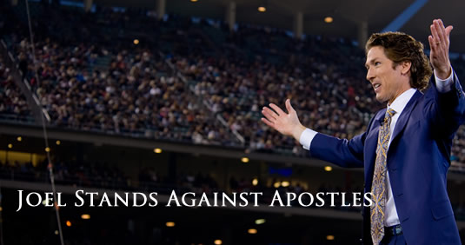
False Prophets
Notes:
According to Joel Osteen – Pastor of Lakewood Church in Houston, Texas, these first century apostles are wrong and outdated and he has come out boldly to imply that Apostles Paul, Peter, and John who wrote much of the New Testament were wrong and need to be corrected and rebuked.
When asked directly by Oprah Winfrey if people who are openly practicing homosexuals are accepted into the Kingdom, Joel Osteen responded with “Absolutely, anybody is.”
Joel Osteen Rebukes Apostles Paul, Peter, and John
Written by Peter Michael Martinez – August 27, 2013
http://unitedforawakening.com/joel-osteen-rebukes-apostles-paul-peter-and-john/
Accessed 26 March 2017

Slide 34
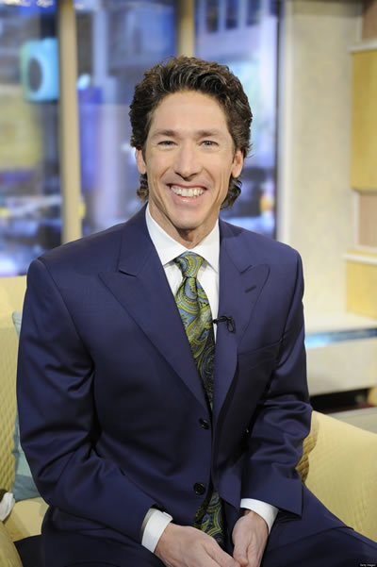
False Prophets
Notes:
Joel does acknowledge that some things are “sin” but says, “I don’t address these things from the pulpit. They only come up in interviews.” When asked by Piers Morgan if openly practicing gay/homosexual people will be accepted into heaven, Joel Osteen responded, “I believe they will.”
Joel Osteen Rebukes Apostles Paul, Peter, and John
Written by Peter Michael Martinez – August 27, 2013
http://unitedforawakening.com/joel-osteen-rebukes-apostles-paul-peter-and-john/
Accessed 26 March 2017

Slide 35
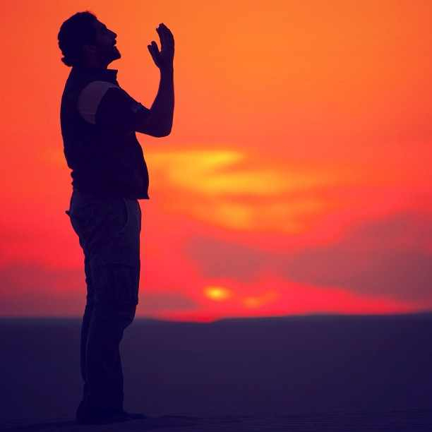
"'And I will destroy those who used to worship me but now no longer do.
They no longer ask for the LORD's guidance or seek my blessings'"
(Zephaniah 1:6 NLT).

Slide 36
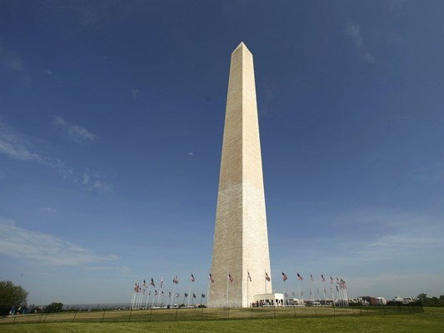
"Stand in silence in the presence of the Sovereign LORD, for the awesome day of the LORD's judgment is near.
The LORD has prepared his people for a great slaughter and has chosen their executioners"
(Zephaniah 1:7 NLT).

Slide 37

"'On that day of judgment,' says the LORD,
'I will punish the leaders and princes of Judah and all those following pagan customs.
⁹Yes, I will punish those who participate in pagan worship ceremonies, and those who fill their masters' houses with violence and deceit"
(Zephaniah 1:8-9 NLT).

Slide 38
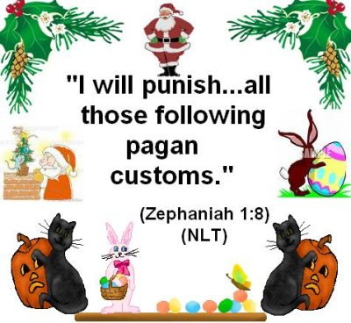
Zephaniah 1:8 (NLT)
"I will punish…all those following pagan customs"
????
Notes:
Judgment will come on the princes and aristocracy who evidence their disobedience by adopting foreign dress and practices (1:7-8).

Slide 39
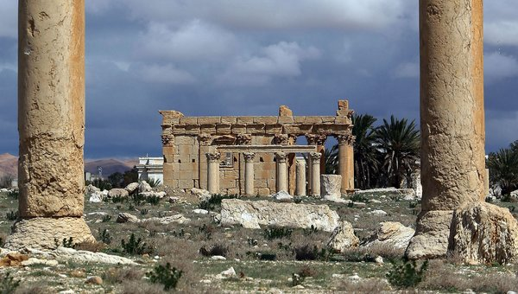
"'On that day,' says the LORD, 'a cry of alarm will come from the Fish Gate and echo throughout the New Quarter of the city. And a great crash will sound from the hills. ¹¹Wail in sorrow, all you who live in the market area, for all the merchants and traders will be destroyed" (Zephaniah 1:10-11 NLT).

Slide 40
"I will search with lanterns in Jerusalem's darkest corners to punish those who sit complacent in their sins. They think the LORD will do nothing to them, either good or bad.
¹³So their property will be plundered, their homes will be ransacked.
They will build new homes but never live in them.
They will plant vineyards but never drink wine from them"
(Zephaniah 1:12-13 NLT).

Slide 41
"That terrible day of the LORD is near.
Swiftly it comes— a day of bitter tears, a day when even strong men will cry out.
¹⁵It will be a day when the LORD's anger is poured out— a day of terrible distress and anguish, a day of ruin and desolation, a day of darkness and gloom, a day of clouds and blackness,
¹⁶a day of trumpet calls and battle cries.
Down go the walled cities and the strongest battlements!"
(Zephaniah 1:14-16 NLT).
day

Slide 42
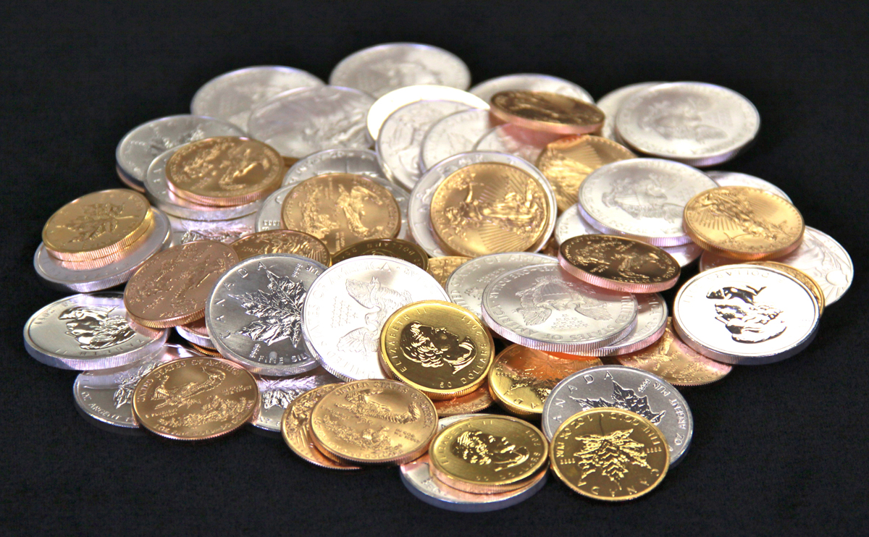
"Because you have sinned against the LORD,
I will make you grope around like the blind.
Your blood will be poured into the dust, and your bodies will lie rotting on the ground.
¹⁸Your silver and gold will not save you on that day of the LORD's anger.
For the whole land will be devoured by the fire of his jealousy.
He will make a terrifying end of all the people on earth"
(Zephaniah 1:17-18 NLT).

Slide 43
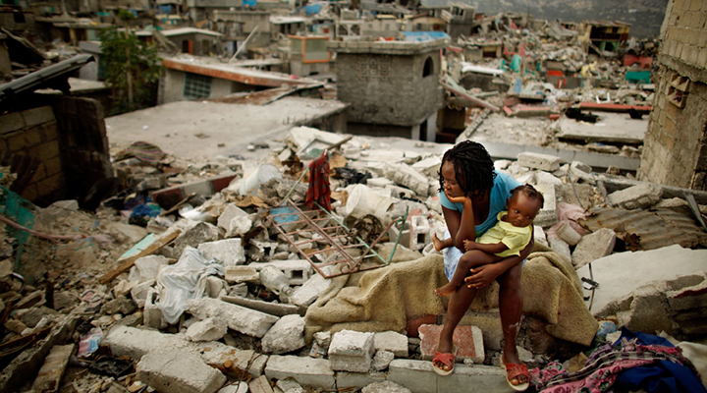
Earthquakes

Slide 44
Slides on
Zephaniah 2

Slide 45
"Gather together—yes, gather together, you shameless nation.
²Gather before judgment begins, before your time to repent is blown away like chaff.
Act now, before the fierce fury of the LORD falls and the terrible day of the LORD's anger begins.
³Seek the LORD, all who are humble, and follow his commands.
Seek to do what is right and to live humbly.
Perhaps even yet the LORD will protect you— protect you from his anger on that day of destruction" (Zephaniah 2:1-3 NLT).

Slide 46
Zephaniah: Day of the LORD
634
Judgment | Salvation
1:1–3:8 | 3:9-20
Day of Punishment | Day of Praise
D-Day | V-Day
Destruction | Deliverance
Ruin | Restoration
God's Righteousness | God's Faithfulness
Warning | Encouragement
Earth 1:1-3 | Judah 1:4–2:3 | Nations 2:4-15 | Jerusalem 3:1-7 | Earth 3:8 |  | Remnant Regathered 3:9-10 | Redeemed & Restored 3:11-20
Judah, Nations, & the Whole Earth (about 630 BC)

Slide 47
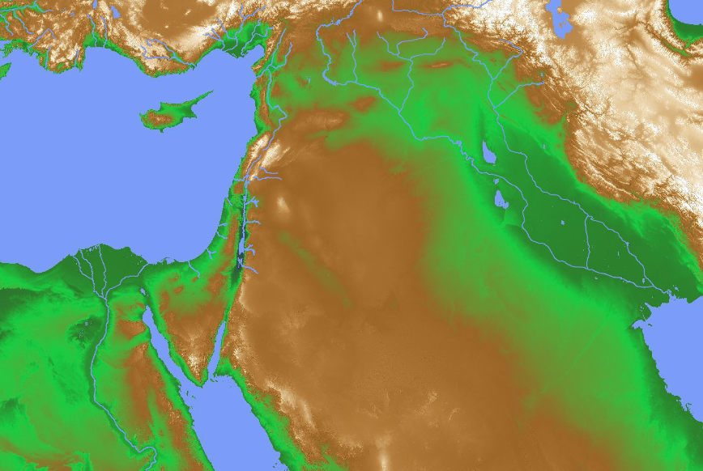
Judgment of the Nations (Zephaniah 2:4-15)
637
Assyria
Philistia
(2:4-7)
Moab (2:8-11)
Edom
Ethiopia

Slide 48
Judgment of Philistia
(Zephaniah 2:4-7)
637
Philistia

Slide 49
"Gaza and Ashkelon will be abandoned,
Ashdod and Ekron torn down.
⁵And what sorrow awaits you Philistines who live along the coast and in the land of Canaan, for this judgment is against you, too!
The LORD will destroy you until not one of you is left.
⁶The Philistine coast will become a wilderness pasture, a place of shepherd camps and enclosures for sheep and goats.
⁷The remnant of the tribe of Judah will pasture there.
They will rest at night in the abandoned houses in Ashkelon. For the LORD their God will visit his people in kindness and restore their prosperity again” (Zephaniah 2:4-7 NLT).

Slide 50
Judgment of Moab & Edom
(Zephaniah 2:8-11)
637
Moab
Edom

Slide 51
"'I have heard the taunts of the Moabites and the insults of the Ammonites, mocking my people and invading their borders.
⁹Now, as surely as I live,' says the LORD of Heaven's Armies, the God of Israel,
'Moab and Ammon will be destroyed— destroyed as completely as Sodom and Gomorrah.
Their land will become a place of stinging nettles, salt pits, and eternal desolation.
The remnant of my people will plunder them and take their land'"
(Zephaniah 2:8-9 NLT).

Slide 52
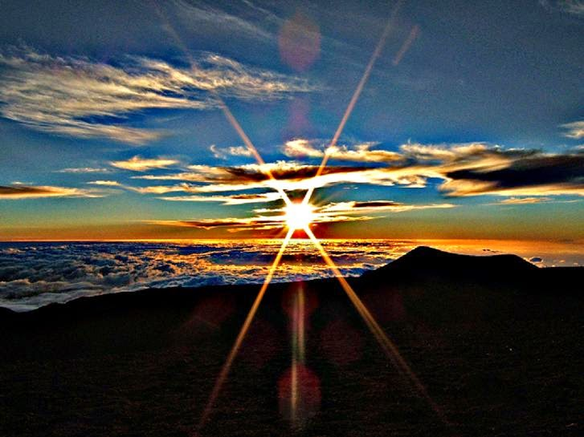
"They will receive the wages of their pride, for they have scoffed at the people of the Lord of Heaven's Armies. ¹¹The LORD will terrify them as he destroys all the gods in the land.
Then nations around the world will worship the LORD, each in their own land"
(Zephaniah 2:10-11 NLT).

Slide 53
Judgment of Ethiopia
(Zephaniah 2:12)
637
Ethiopia

Slide 54
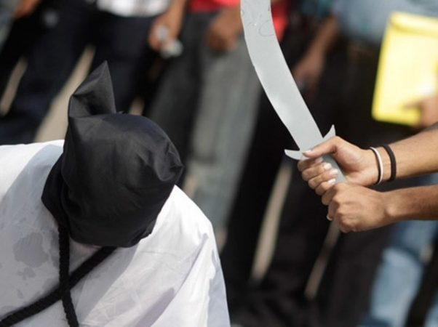
"'You Ethiopians will also be slaughtered by my sword,' says the LORD"
(Zephaniah 2:12 NLT).

Slide 55
Judgment of Assyria
(Zephaniah 2:13-15)
637
Assyria

Slide 56
"And the LORD will strike the lands of the north with his fist, destroying the land of Assyria.
He will make its great capital, Nineveh, a desolate wasteland, parched like a desert.
¹⁴ The proud city will become a pasture for flocks and herds, and all sorts of wild animals will settle there.
The desert owl and screech owl will roost on its ruined columns, their calls echoing through the gaping windows.
Rubble will block all the doorways, and the cedar paneling will be exposed to the weather” (Zephaniah 2:13-14 NLT).

Slide 57
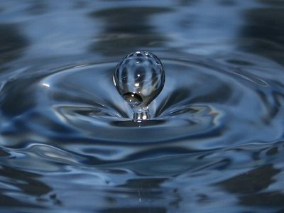
Nineveh's Water System Destroyed
637
"And He will stretch out His hand against the north and destroy Assyria, and He will make Nineveh a desolation, parched like the wilderness" (Zeph. 2:13)
The prophesied destruction of Nineveh (Zeph. 2:13), the capital of Assyria in what is now Iraq, fell in 612 BC into the hands of the neighboring Babylonians, with the whole empire taken by 605 BC. The prediction that God would leave Nineveh "dry as a desert" is remarkable in view of the fame of the city's great irrigation system.

Slide 58
The Assyrian Threat
Assyrian Expansion
Nineveh
Mediterranean
Sea
Syria
Israel
Judah
Persian
Gulf
Egypt

Slide 59

100 Years Later…
ASSYRIA
Tiglath-Pilesar
Assyria Strong
Jonah 760
Nahum 660
Nineveh's Fall 612
Israel's Fall 722
Zephaniah 630
1100
900
850
800
750
700
650
600
Nineveh's Relapse

Slide 60
Nahum, Zephaniah, & Their Contemporaries
560
660 650 640 630 620 610 600 590 580 570 560 550 540 530 520
Ashuretililani
Sinsharishkun
Ashuruballit ii
Kings of Assyria
Ashurbanipal
Fall of Nineveh
663 BC
Fall of Thebes
Nahum
660
612
609 605 539
World powers
Assyrian
Babylonian
Persian
Zephaniah
630
Jehoiakim
zedekiah
Judah
Kings of Judah
Captivity of Judah to Babylon (586)
Return from Exile
Manasseh
Josiah
Amon
Jehoahaz
Jehoiachin
Habakkuk
606
Notes:
Here was the time in Israel’s divided kingdom when Judah recently saw their godly king Josiah killed in 609 while God raised up many prophets to warn the people. In addition to Nahum, Zephaniah, and Habakkuk, others not depicted here include Jeremiah and Joel in Judah and Ezekiel and Daniel in Babylon.
_____________
Common Arabic-288
BE-35-Habakkuk-17
OS-34-Zephaniah-60
OS-35-Habakkuk-43

Slide 61
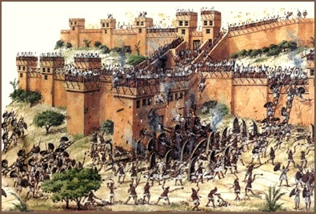
Nineveh:
Destroyed by Flood and Fire

Slide 62
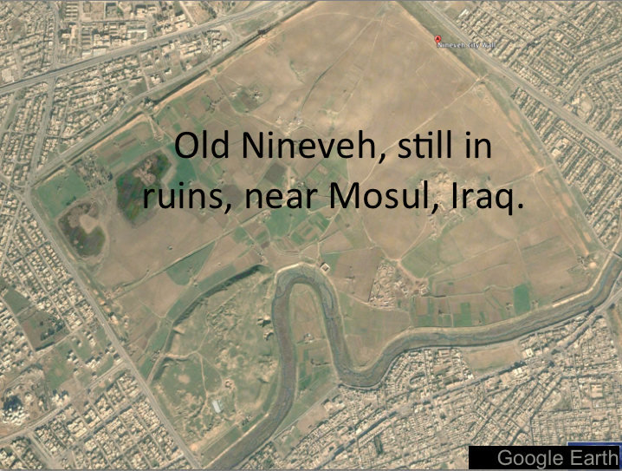
Modern Map
Mosul, Iraq, surrounds Nineveh’s ancient ruins
Notes:
OS-34-Nahum-112
OS-36-Zephaniah-101

Slide 63
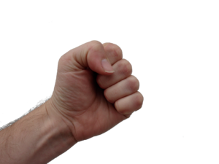
"This is the boisterous city, once so secure.
'I am the greatest!' it boasted.
'No other city can compare with me!'
But now, look how it has become an utter ruin, a haven for wild animals.
Everyone passing by will laugh in derision and shake a defiant fist"
(Zephaniah 2:15 NLT).

Slide 64
Zephaniah: Day of the LORD
634
Judgment | Salvation
1:1–3:8 | 3:9-20
Day of Punishment | Day of Praise
D-Day | V-Day
Destruction | Deliverance
Ruin | Restoration
God's Righteousness | God's Faithfulness
Warning | Encouragement
Earth 1:1-3 | Judah 1:4–2:3 | Nations 2:4-15 | Jerusalem 3:1-7 | Earth 3:8 |  | Remnant Regathered 3:9-10 | Redeemed & Restored 3:11-20
Judah, Nations, & the Whole Earth (about 630 BC)

Slide 65
Slides on
Zephaniah 3

Slide 66
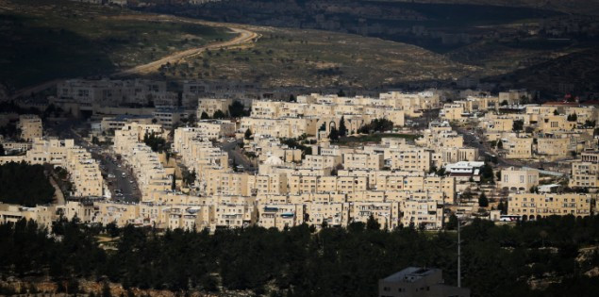
"What sorrow awaits rebellious, polluted Jerusalem, the city of violence and crime!
²No one can tell it anything; it refuses all correction.
It does not trust in the LORD or draw near to its God"
(Zephaniah 3:1-2 NLT).

Slide 67
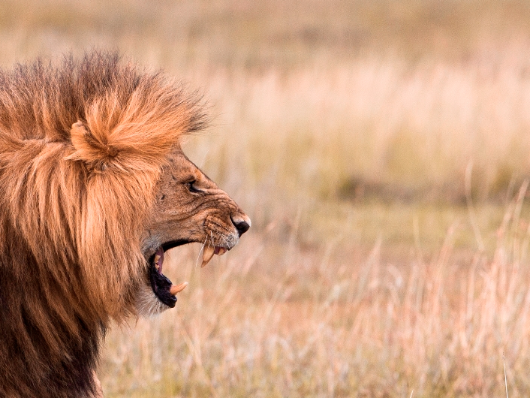
"Its leaders are like roaring lions hunting for their victims.
Its judges are like ravenous wolves at evening time, who by dawn have left no trace of their prey"
(Zephaniah 3:3 NLT).

Slide 68

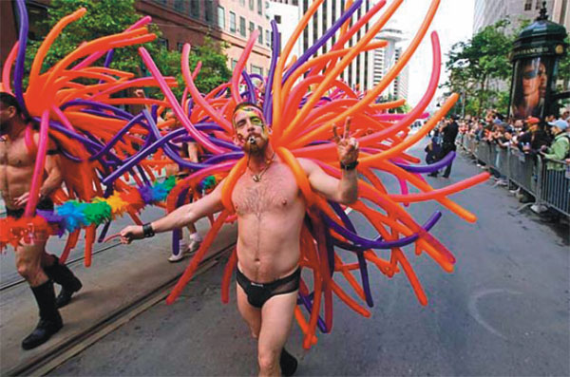
"[Jerusalem's] prophets are arrogant liars seeking their own gain.
Its priests defile the Temple by disobeying God's instructions.
⁵But the LORD is still there in the city, and he does no wrong.
Day by day he hands down justice, and he does not fail.
But the wicked know no shame"
(Zephaniah 3:4-5 NLT).

Slide 69
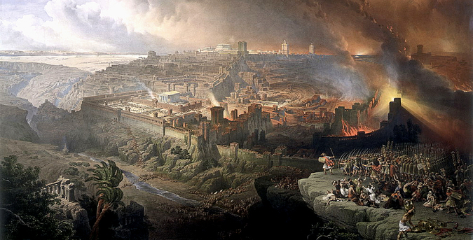
"I have wiped out many nations, devastating their fortress walls and towers.
Their streets are now deserted; their cities lie in silent ruin.
There are no survivors—none at all"
(Zephaniah 3:6 NLT).

Slide 70
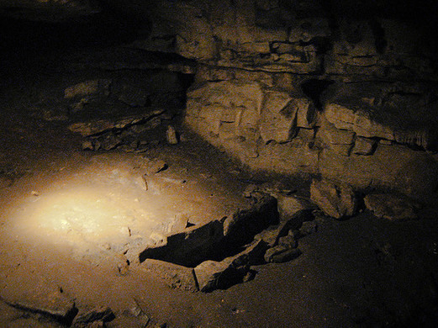
"I thought,
'Surely they will have reverence for me now!
Surely they will listen to my warnings.
Then I won't need to strike again, destroying their homes.'
But no, they get up early to continue their evil deeds"
(Zephaniah 3:7 NLT).

Slide 71
Zephaniah: Day of the LORD
634
Judgment | Salvation
1:1–3:8 | 3:9-20
Day of Punishment | Day of Praise
D-Day | V-Day
Destruction | Deliverance
Ruin | Restoration
God's Righteousness | God's Faithfulness
Warning | Encouragement
Earth 1:1-3 | Judah 1:4–2:3 | Nations 2:4-15 | Jerusalem 3:1-7 | Earth 3:8 |  | Remnant Regathered 3:9-10 | Redeemed & Restored 3:11-20
Judah, Nations, & the Whole Earth (about 630 BC)

Slide 72
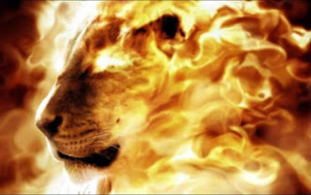
"'Therefore, be patient,' says the LORD.
'Soon I will stand and accuse these evil nations.
For I have decided to gather the kingdoms of the earth and pour out my fiercest anger and fury on them. All the earth will be devoured by the fire of my jealousy"
(Zephaniah 3:8 NLT).

Slide 73
PEOPLE ON
EARTH
HATE TO HEAR THE WORD REPENT!
THOSE IN
HADES
WISH THEY COULD
HEAR IT
JUST ONCE MORE
Notes:
Repentance literally means a change of mind—don’t trust yourself but change your mind to trust God instead. The “fruits of repentance” then mean a change of behavior based on whom you lean on. The basics are in 2:3:
Seek the LORD. Don’t seek idols.
Seek righteousness. Don’t seek what is expedient.
Seek humility. Don’t lift up yourself but lift up others.
Have you changed your mind about whom you trust—and that shows in a humble, pure life?
The NT in 1 Corinthians 3 says that your works will be like materials set on fire. That’s a severe warning. Only the lasting ones will last and be rewarded.

Slide 74
How should we respond to the LORD’s balance?
Judgment
Deliverance
Repentance
Hope

Slide 75

II. God’s future deliverance encourages us to hope.
Zephaniah 3:9-20
Notes:
The LORD will reward you, so live with anticipation now .

Slide 76
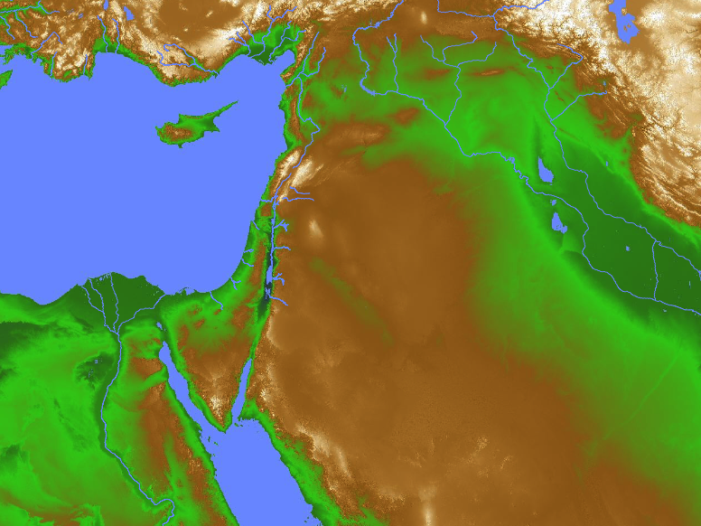
Ethiopia Worship
(Zephaniah 3:9-11)
"Then I will purify the speech of all people, so that everyone can worship the LORD together. ¹⁰My scattered people who live beyond the rivers of Ethiopia will come to present their offerings. ¹¹On that day you will no longer need to be ashamed, for you will no longer be rebels against me. I will remove all proud and arrogant people from among you. There will be no more haughtiness on my holy mountain."
Israel
Ethiopia

Slide 77
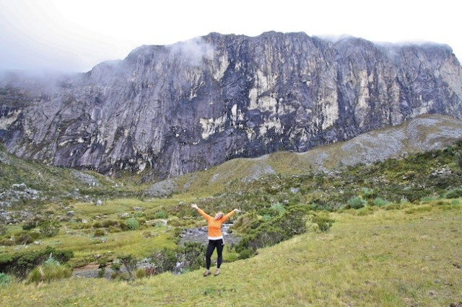
"Those who are left will be the lowly and humble, for it is they who trust in the name of the LORD.
¹³The remnant of Israel will do no wrong; they will never tell lies or deceive one another.
They will eat and sleep in safety, and no one will make them afraid"
(Zephaniah 3:12-13 NLT).

Slide 78
"Sing, O daughter of Zion; shout aloud, O Israel!
Be glad and rejoice with all your heart,
O daughter of Jerusalem!
¹⁵For the LORD will remove his hand of judgment and will disperse the armies of your enemy.
And the LORD himself, the King of Israel, will live among you!
At last your troubles will be over, and you will never again fear disaster"
(Zephaniah 3:14-15 NLT).

Slide 79
"On that day the announcement to Jerusalem will be,
'Cheer up, Zion! Don't be afraid!
¹⁷For the LORD your God is living among you.
He is a mighty savior.
He will take delight in you with gladness.
With his love, he will calm all your fears.
He will rejoice over you with joyful songs"
(Zephaniah 3:16-17 NLT).

Slide 80
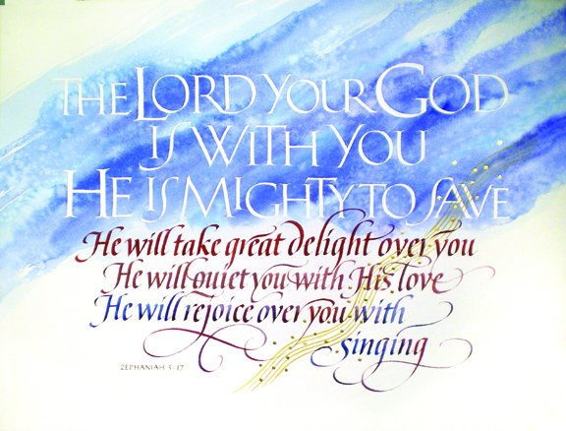
Zephaniah 3:17

Slide 81
"I will gather you who mourn for the appointed festivals; you will be disgraced no more.
¹⁹And I will deal severely with all who have oppressed you.
I will save the weak and helpless ones;
I will bring together those who were chased away.
I will give glory and fame to my former exiles, wherever they have been mocked and shamed"
(Zephaniah 3:18-19 NLT).

Slide 82
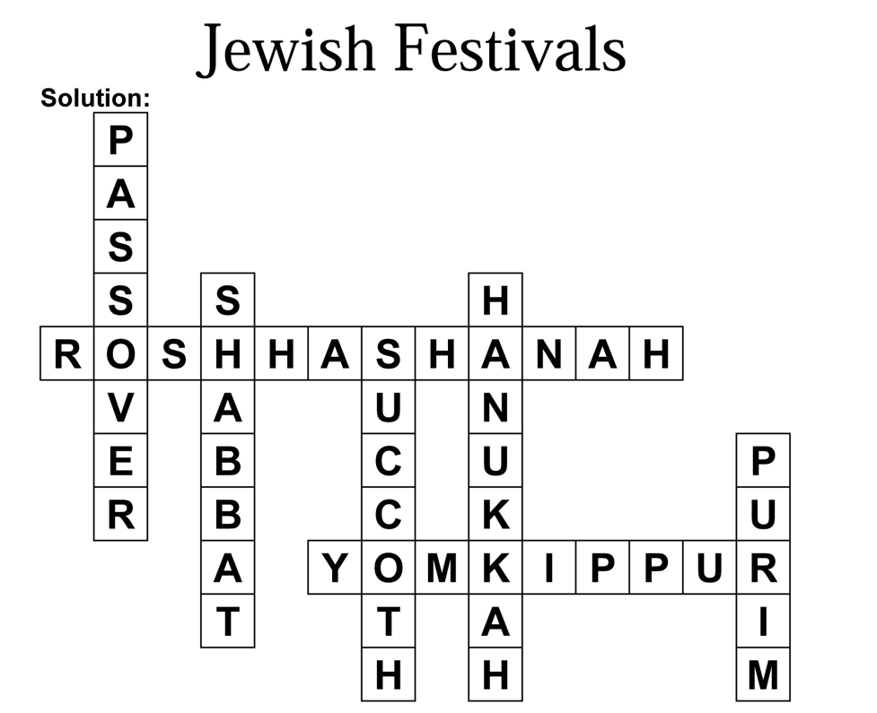
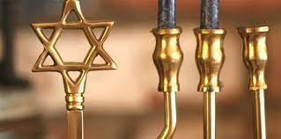
Should we follow the festivals or Colossians 2:16-17?
"I will gather you who mourn for the appointed festivals; you will be disgraced no more"
(Zeph. 3:18 NLT).
Jewish Festivals

Slide 83
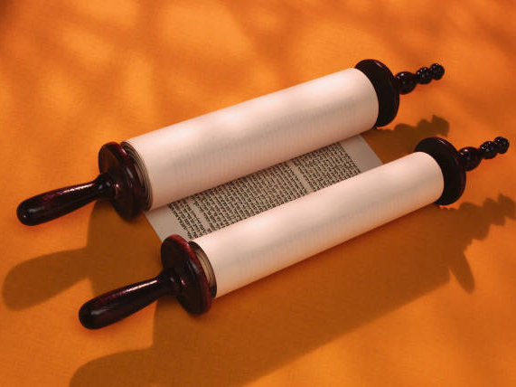
Jewish: The Law is Good
but…

Slide 84
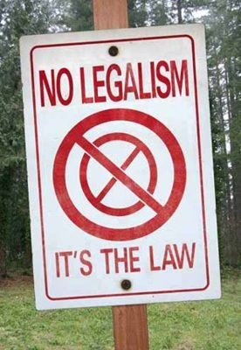
No Legalism!
"So don't let anyone condemn you for what you eat or drink, or for not celebrating certain holy days or new moon ceremonies or Sabbaths. ¹⁷For these rules are only shadows of the reality yet to come. And Christ himself is that reality" (Col. 2:16-17 NLT)

Slide 85
"On that day I will gather you together and bring you home again.
I will give you a good name, a name of distinction, among all the nations of the earth, as I restore your fortunes before their very eyes.
I, the LORD, have spoken!"
(Zephaniah 3:20 NLT).

Slide 86
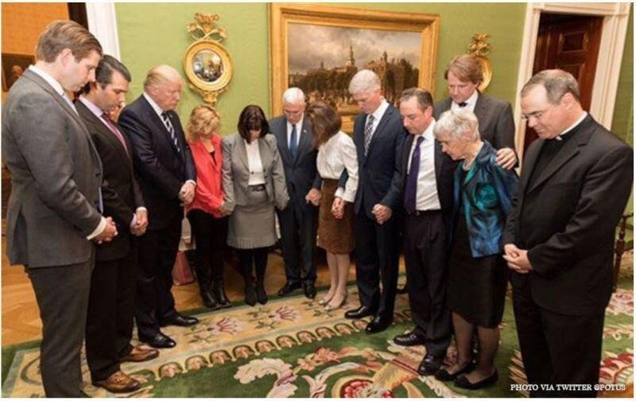
Hope
Notes:
At the confirmation of Neil Gorsuch, President Trump and his advisors bowed to give thanks to God. Prayer in the government is certainly not out of line, for prayer has been offered each morning at the beginning of the Senate for over 200 years!

Slide 87

Judgment!

Slide 88

Blessing!

Slide 89


The Day of the LORD
638-639
Judgment
+
Blessing
Tribulation
Millennium
Rev. 6–19
Rev. 20
7 years
1000 years

Slide 90
A Timeline of the Future
437
Great
White
Throne
(Rev. 20:11-14)
Rapture
(1 Thess. 4:13-18)
2nd Advent
(Zech. 14:3-5)
Day of the LORD
Church Age
Tribulation
(Zech. 14:1-2)
Millennium
(Zech. 14:6-21)
Gog & Magog
(Armageddon)
(Ezek. 38–39)
Gog and Magog
Revisited
(Rev. 20:7-10)
Notes:
90
But how does this give you hope?
Does it affect how you use your money? Do you “lay up for yourself treasures in heaven” as a result?
How does it impact your use of time? Do you say, “That movie isn’t necessarily wrong, but I could us my time much better by investing God’s Word into others!”

Slide 91

Zephaniah
The Day of the LORD

Slide 92
Key Word
634
343
Day
Zephaniah

Slide 93
How should we respond to the LORD’s balance?
Judgment
Deliverance
Repentance
Hope

Slide 94

Main Idea
Be hopeful yet repentant.
Zephaniah
Notes:
Balance your anticipation with right thinking.

Slide 95

Zephaniah Kingdom Statement
343
Judah should repent because of a future day of judgment (1:1–3:8) and blessing (3:9-20) on the whole earth caused by God as King.

Slide 96

Zephaniah
Summary Statement
634
346
Zephaniah prophesies the day of the LORD judgment upon Judah, the surrounding nations, and the entire earth to exhort Judah to repent due to God's righteousness and His promise of a remnant in a national restoration.

Slide 97
I. God’s future judgment warns us to repent.
Zephaniah 1:1–3:8
Notes:
The LORD will hold you accountable, so change your mind about him now.

Slide 98
II. God’s future deliverance encourages us to hope.
Zephaniah 3:9-20
Notes:
The LORD will reward you, so live with anticipation now .

Slide 99
Key Verse
634
"Gather together…before the day of the LORD's wrath comes upon you. Seek the LORD, all you humble of the land, you who do what he commands. Seek righteousness, seek humility; perhaps you will be sheltered on the day of the LORD's anger" (Zephaniah 2:1-3).
Zephaniah

Slide 100

"The LORD your God is with you, he is mighty to save. He will take great delight in you, he will quiet you with his love, he will rejoice over you with singing"
(Zephaniah 3:17)

Slide 101
Black

Slide 102


OT Sermons link at BibleStudyDownloads.org
Get this presentation and script for free!

