Slide 1
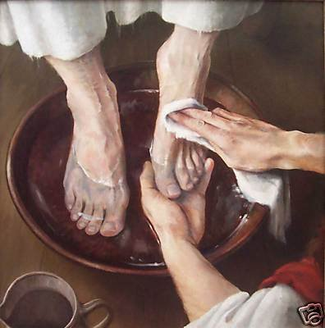
Be Serving
Matthew
Dr. Rick Griffith • Crossroads International Church Singapore
BibleStudyDownloads.org

Slide 2
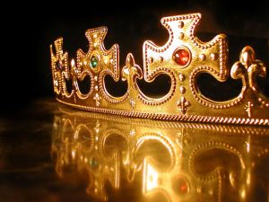
In your small group…
Matthew presents Christ as King of Israel. Do you think Christians today have a hard time thinking of Christ as King?
Why or why not?

Slide 3
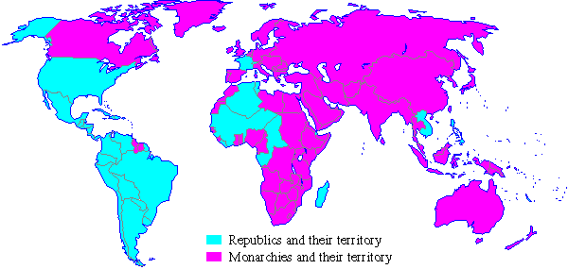
Monarchies in 1900
Notes:
A quick look at the world map a century ago shows that most of the world was ruled by kings in 1900.

Slide 4
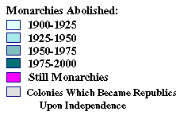
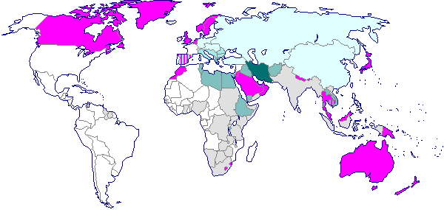
Monarchies in 2000
Notes:
However, a century later, few monarchies are left. Even Britain, Japan, Canada, Australia and perhaps Scandinavian countries are not monarchies in the practical sense.

Slide 5
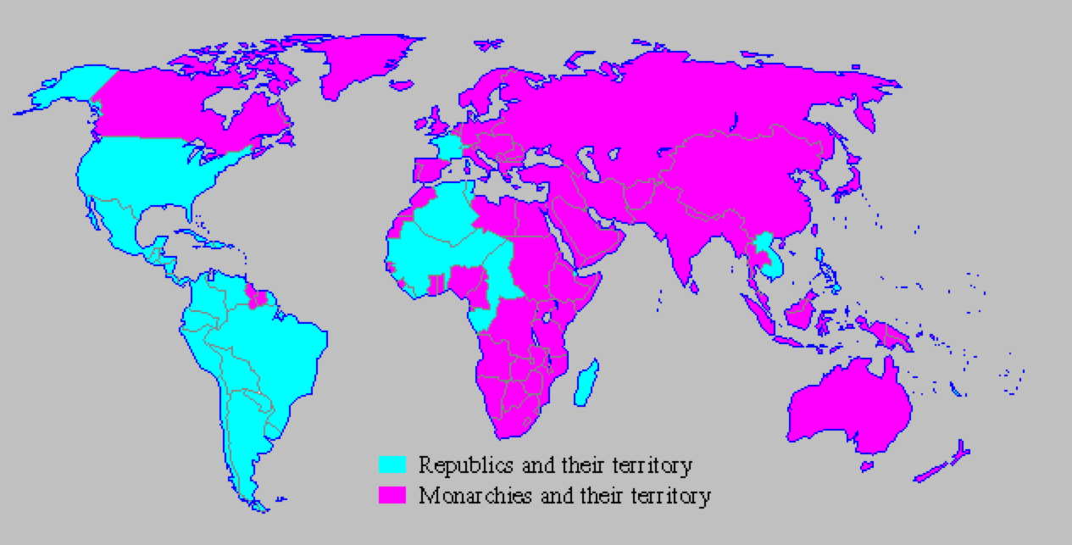
The Demise of Monarchies
Monarchies in 1900
Monarchies in 2000
Notes:
I wonder if the demise of monarchies affects the way we look at Jesus in terms of him being king.

Slide 6

Let's Study Through Scripture
The Bible: Book by Book
Notes:
We are in a study through the whole Bible right now, book by book. The goal is to give us a basic understanding of each book of the Bible.
OP-01-Gen-06
OP-02-Lev-05
OS-09-1Sam-34
OS-10-2Sam-48
OS-12-2Kings-94
OS-13-1Chron-41
OS-14-2Chron-63
NT-01-Matt-57

Slide 7

New Testament Book Studies

Slide 8
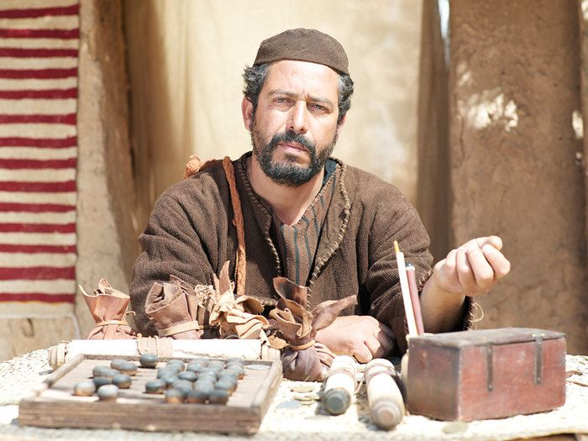
Who was Matthew?
Tax Collecter
Notes:
8

Slide 9


When I Think They Were Written…
51a
1
MATTHEW
2
MARK
TO:
JEWS
TO:
ROMANS
The A.D.40s
A.D. 64-68
AS:
KING
AS:
SERVANT
WHAT
HE:
WHAT
HE:
SAID
DID
3
LUKE
4
JOHN
GREEKS
CHURCH
A.D. 57-59
A.D. 69 AFTER THE SYNOPTICS
TO:
TO:
AS:
GOD/MAN
AS:
GOD
WHAT
HE:
WHAT
HE:
FELT
MEANT
27
4
Notes:
Now…what about the dates of the writing of these crucial documents? And here we are left to our best scholarly guesses. There will ALWAYS be argument here. But some of the best guesses, based on decades of academic research and study are these – in suggested order…
//// MATTHEW…composed sometime during the A.D. 40s…
//// LUKE is suggested as next, between the years A.D. 57 and 59 A.D…
//// Mark…in the next decade…between 64 and 68…
//// and finally…John's Gospel…around A.D. 69….but certainly after the Synoptics were set down. Again, you will always find disagreement on these dates. However, these dates are from the research of well-known Christian scholars and teachers.

Slide 10
NT Overview (History)
38
124
39-41
"To the remotest part of the earth" (Acts 1:8)
Acts 9 13 14 15 16 18 21 27 28
Apr 48-
Sep 49
1
Galatia
Apr 50-
Sep 52
2
Aegean
Spr 53-
May 57
3
Asia
Feb 60-
Mar 62
1
Rome
Spr 62-
Fall 67
4
Spain
Aut 67-
Spr 68
2
Rome
Summer 35-
37
Damascus
Antioch
May 57-
Aug 59
Trials
Fall 49
The
Council
Spring 68
Expansion of Church
35 48 49 50 52 53 57 60 62 67 68 95
Matthew
Israel
40s
Kingdom
Gospels & Acts
1234
Journeys
Rome
Imprisonments
Gospels & Acts

Slide 11
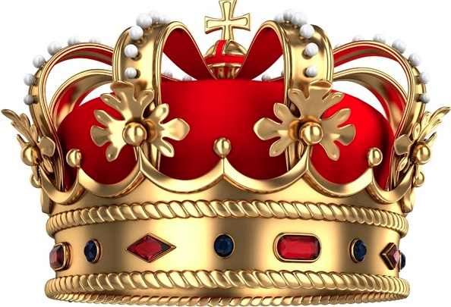

Matthew claims that Jesus fulfilled all the requirements to be Israel's king.

Slide 12

Matthew: Christ as King
"Judah, my son, is a young lion that has finished eating its prey. Like a lion he crouches and lies down; like a lioness—who dares to rouse him?
¹⁰The scepter will not depart from Judah, nor the ruler's staff from his descendants, until the coming of the one to whom it belongs, the one whom all nations will honor" (NLT).
Since Jacob's blessing in Genesis 49:9-10, the lion has depicted a king…

Slide 13
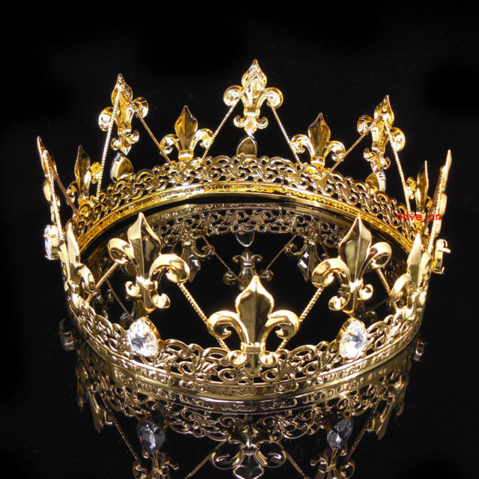
How do you respond to a king?

Slide 14
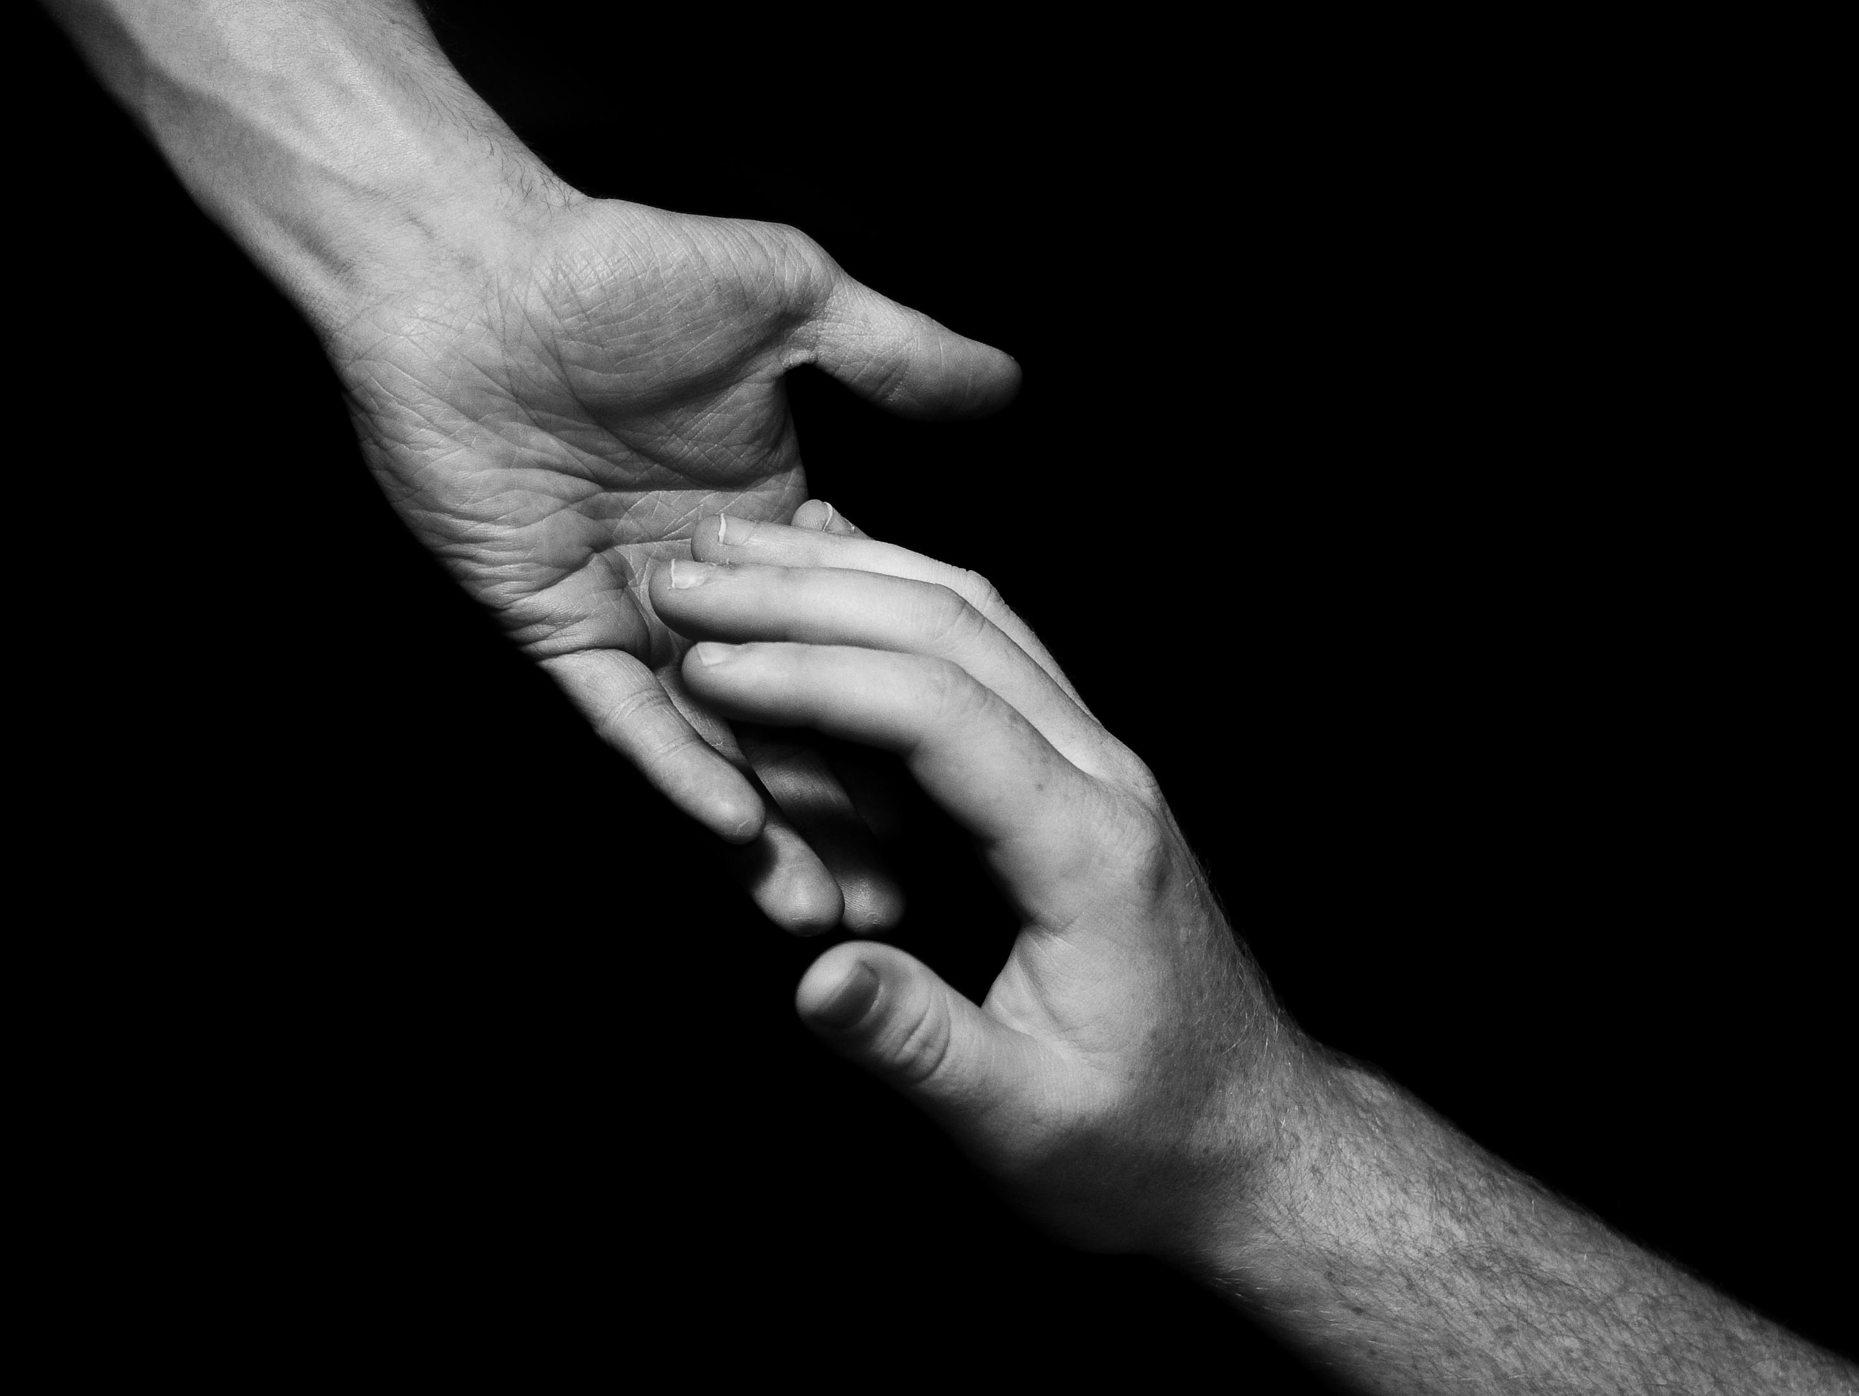
Be serving
Notes:
The natural response is to serve him.

Slide 15
Why serve Jesus?

Slide 16
3 Reasons • 3 Amazing Names
Lord
Jesus
Christ
Notes:
We’ll see three reasons to serve Jesus in Matthew’s gospel that correlate with the three names we ascribe to him: Lord Jesus Christ.
We need to understand what it means for our Jesus to be the Lord Jesus Christ.
Do you agree that the name of Jesus is the most dishonored in the world? Few people swear by the name of any other religious or political or other leader.
Even Christians don't often think much about the three main names of Jesus noted 60 times in the NT.

Slide 17
Amazing Names
Jesus is the highest ruler in the world (Matt 1–10).
Christ
Notes:
[Jesus met every prophecy we should expect for him to prove he is King.]
[Christ means Messiah-Ruler, for he fulfilled each part of his job description.]
The designation “Christ” is probably the most misunderstood term about our Saviour. The Greek Christos means “1. fulfiller of Israelite expectation of a deliverer, the Anointed One, the Messiah, the Christ” and “2. the personal name ascribed to Jesus” (BDAG 1091). First-century Gentiles often confused Christos with the similar sounding name Chrestos, which was simply a surname, but it means far more!
So what does it mean that Jesus is the “Messiah,” or “Anointed One”? At their appointments in the OT, both priests and kings were anointed, yet here it means that Jesus is the Anointed King. The magi saw this clearly since they sought the “king of the Jews” (Matt 2:2), and Herod confirmed that “Messiah” means “king” when he asked where the Messiah would be born (Matt 2:4).

Slide 18
Slides on
Matthew 1

Slide 19
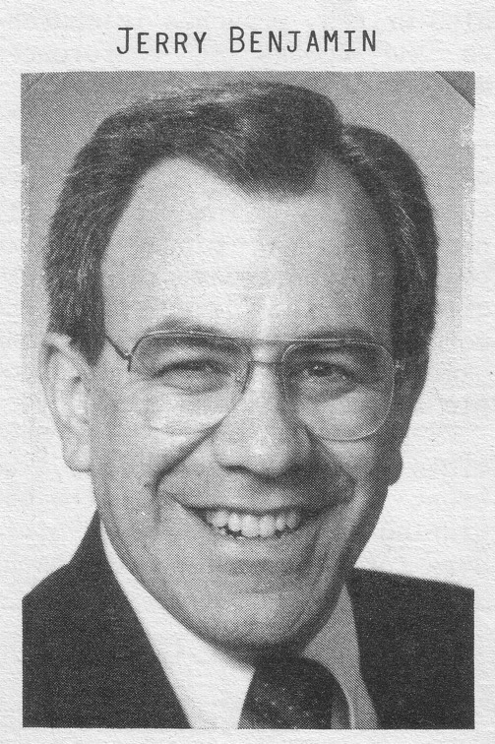
A boring way to begin a book?
ESV Matthew 1:1 The book of the genealogy of Jesus Christ, the son of David, the son of Abraham. 2 Abraham was the father of Isaac, and Isaac the father of Jacob, and Jacob the father of Judah and his brothers, 3 and Judah the father of Perez and Zerah by Tamar, and Perez the father of Hezron, and Hezron the father of Ram, 4 and Ram the father of Amminadab, and Amminadab the father of Nahshon, and Nahshon the father of Salmon, 5 and Salmon the father of Boaz by Rahab, and Boaz the father of Obed by Ruth, and Obed the father of Jesse, 6 and Jesse the father of David the king. And David was the father of Solomon by the wife of Uriah, 7 and Solomon the father of Rehoboam, and Rehoboam the father of Abijah, and Abijah the father of Asaph, 8 and Asaph the father of Jehoshaphat, and Jehoshaphat the father of Joram, and Joram the father of Uzziah, 9 and Uzziah the father of Jotham, and Jotham the father of Ahaz, and Ahaz the father of Hezekiah, 10 and Hezekiah the father of Manasseh, and Manasseh the father of Amos, and Amos the father of Josiah, 11 and Josiah the father of Jechoniah and his brothers, at the time of the deportation to Babylon. 12 And after the deportation to Babylon: Jechoniah was the father of Shealtiel, and Shealtiel the father of Zerubbabel, 13 and Zerubbabel the father of Abiud, and Abiud the father of Eliakim, and Eliakim the father of Azor, 14 and Azor the father of Zadok, and Zadok the father of Achim, and Achim the father of Eliud, 15 and Eliud the father of Eleazar, and Eleazar the father of Matthan, and Matthan the father of Jacob, 16 and Jacob the father of Joseph the husband of Mary, of whom Jesus was born, who is called Christ.
Jeremiah Benjamin
"The first verse stunned me," Jerry recalls. "It said that Jesus was related to my forefathers."
Notes:
Most of us, if we are honest, find that the first few verses of the NT are boring. They may be good for getting us to sleep if we have insomnia, but they aren't generally appreciate as literature [read 1:1-3 with a yawn].
While I was a student at Dallas Seminary, I had the privilege of meeting Jeremiah Benjamin—a true Jewish name if you ever heard one! Jerry was from such a strictly orthodox Jewish family that the New Testament was forbidden in his home. However, a Christian student once gave him a NT and challenged him to read it. So he snuck into his room, climbed into bed, pulled the sheets over him and took out his flashlight.
[Animation] "The first verse stunned me," Jerry later recalled. "It said that Jesus was related to my forefathers."
My experience with Jerry helped me to see that Matthew's beginning didn't interest me because I am a Gentile who wasn't looking for Israel's king. I didn't even know what questions to ask or what to look for. But Matthew was written for the Jewish heart and mind. Therefore, he starts off with a bang: Jesus was actually a direct descendant of King David and therefore fulfilled the lineage necessary to be Israel's king!

Slide 20
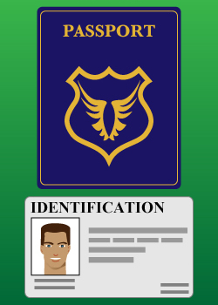
Proof That Jesus is King
PASSPORT
IDENTIFICATION
Notes:
"Persons traveling by plane to another country must identify themselves. Picture identification, like a driver's license and a passport, are usually required. These identifiers are carefully examined to ensure that all the passengers are safe from harm. A man who identifies himself as the Messiah also needs the correct identification. For instance, He must be descended from the line of David, be born in the right city, be born at the right time, and be able to perform amazing works" (Rick Griffith, "Advanced Studies in the NT," Lesson 1, Topic 3, internetseminary.org accessed 17 Jan 2016).

Slide 21
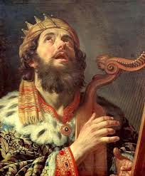
David Listed Before Abraham
"This is a record of the ancestors of Jesus the Messiah, a descendant of David and of Abraham"
(Matt. 1:1 NLT)

Slide 22
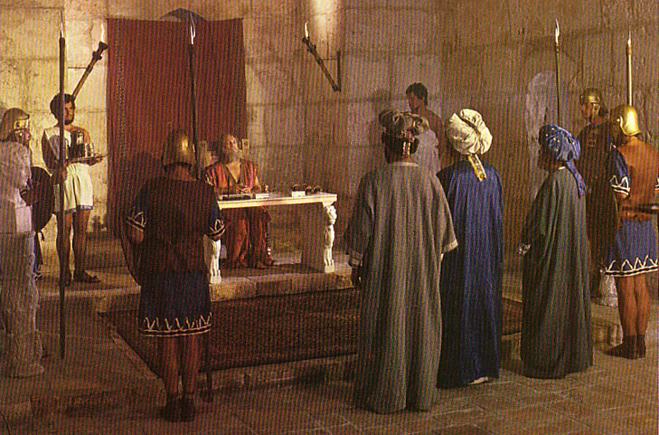
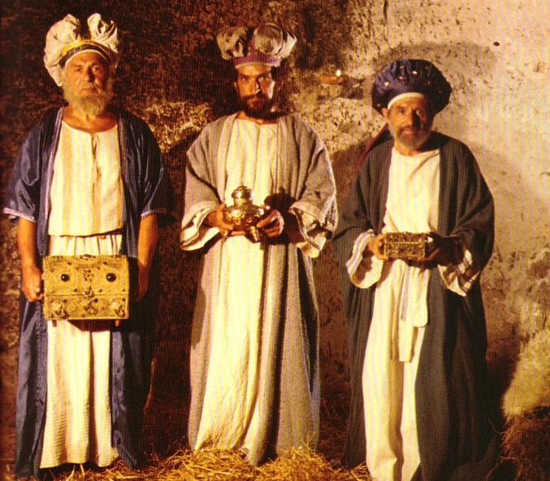
What Kind of Kingdom Did Isaiah
(and Matthew) Envision?
78b
Political
Physical
Emotional
Intellectual
Spiritual

Slide 23
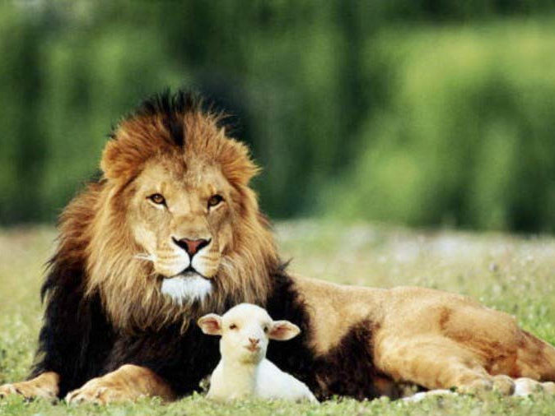
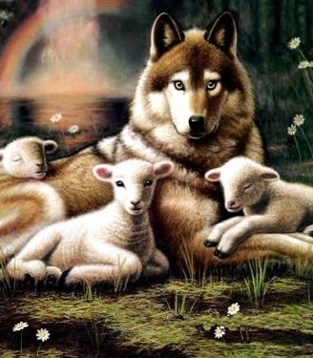
Isaiah 11:6-9
NTS 434
"And the wolf will dwell with the lamb, and the leopard will lie down with the young goat, and the calf and the young lion and the fatling together."
Isa. 11:6
Notes:
23

Slide 24
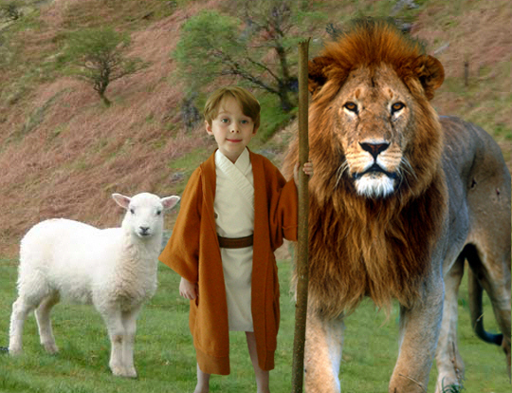
Isaiah 11:6-9
434
"And the wolf will dwell with the lamb, and the leopard will lie down with the young goat, and the calf and the young lion and the fatling together; and a little boy will lead them."
Notes:
24

Slide 25
Matthew Chart
67
Messiah with Authority over the Church
Preliminary Evidence that Christ is Messiah
Rejections and
Interadvent Age
Final Evidence that
Christ is Messiah
Chapters 1–10
Chapters 11–27
Chapter 28
The King Rejected
The King Re-offered
The King Offered
Teaches Droves
Teaches Disciples
Topical
Chronological

Slide 26
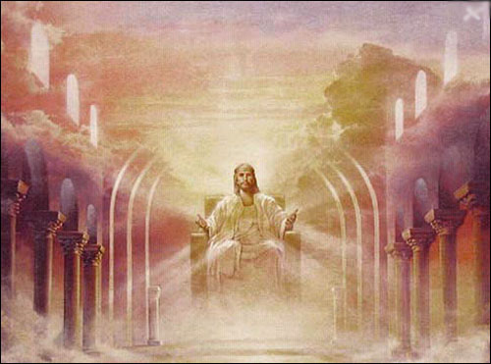
A Literal, Political Kingdom
"Jesus replied,
'I assure you that when the world is made new and the Son of Man sits upon his glorious throne, you who have been my followers will also sit on twelve thrones, judging the twelve tribes of Israel'"
(Matt. 19:28 NLT)

Slide 27
Summary Statement
67
Summary Statement
Matthew:
(1) proves Jesus as Messiah for unbelieving Jews to trust Him, and
(2) explains that the kingdom is postponed due to Israel's rejection of Christ as King for believing Jews to see His present kingdom authority as residing in the Church.

Slide 28
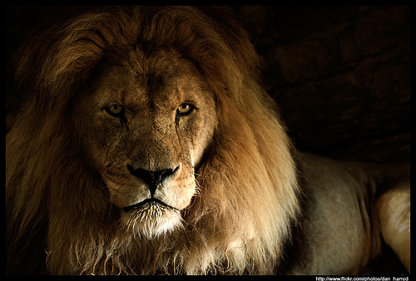
The Kingdom in Matthew 1
Fall of the Kingdom
Establishing the Eternal Kingdom
ABRAHAM
Solomon
Shealtiel
Isaac
Rehoboam
Zerubbabel
Jacob
Abijah
Abiud
Judah
Asa
Eliakim
Perez
Jehoshaphat
Azor
"Thus there were fourteen generations in all from Abraham to David, fourteen from David to the exile to Babylon, and fourteen from the exile to Christ."
Matthew 1:17
Ahaziah
Hezron
Jehoram
Zadok
Joash
Ram
Uzziah
Akim
Amaziah
Amminadab
Jotham
Eliud
Nahshon
Ahaz
Eleazar
Salmon
Hezekiah
Matthan
Boaz
Manasseh
Jacob
Obed
Amon
Joseph +
Mary
Rise of the Kingdom
Jesse
Josiah
KING DAVID
JECONIAH (EXILE)
JESUS CHRIST

Slide 29
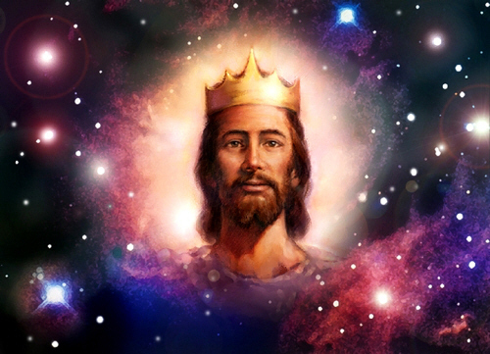
Matthew says Jesus is King!

Slide 30
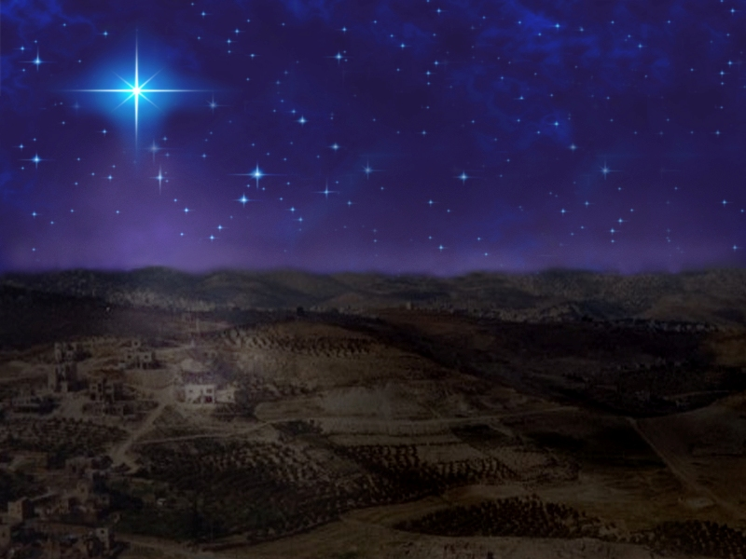
Bethlehem
"And you, O Bethlehem in the land of Judah, are not least among the ruling cities of Judah, for a ruler will come from you who will be the shepherd for my people Israel"
(Micah 5:2 quoted in Matthew 2:6 NLT)

Slide 31
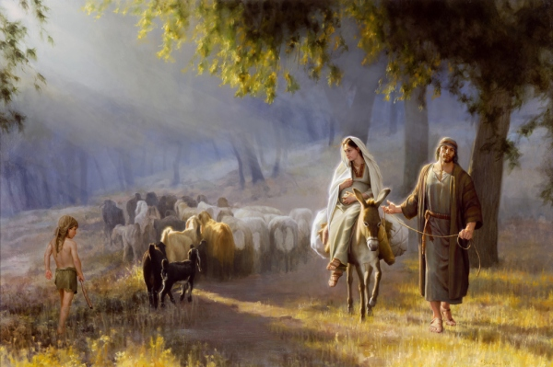
Journey to Bethlehem

Slide 32
Slides on
Matthew 2

Slide 33
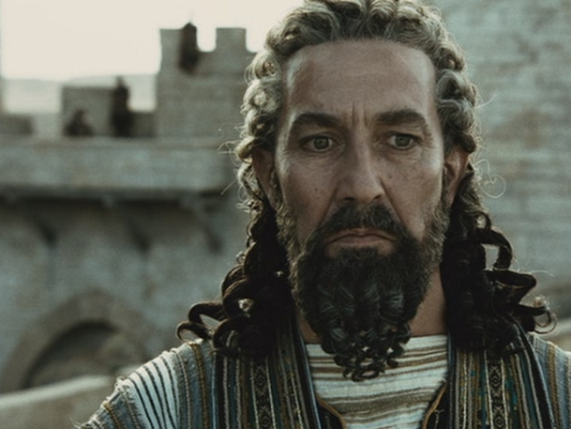
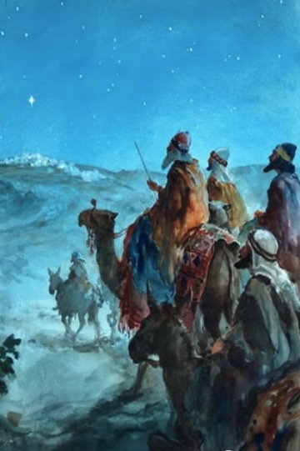
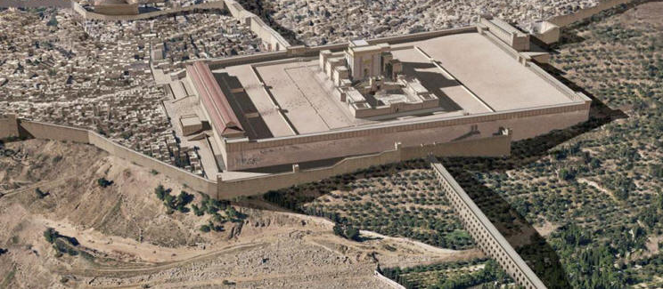
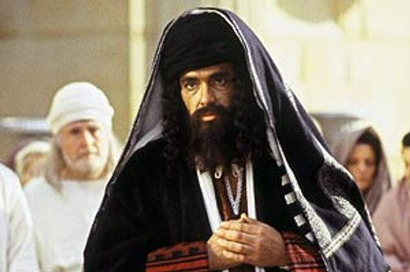
Responses to Jesus
Gentiles seeking
Herod opposed
Jerusalem disturbed
Leaders ignored

Slide 34
Slides on
Matthew 3

Slide 35
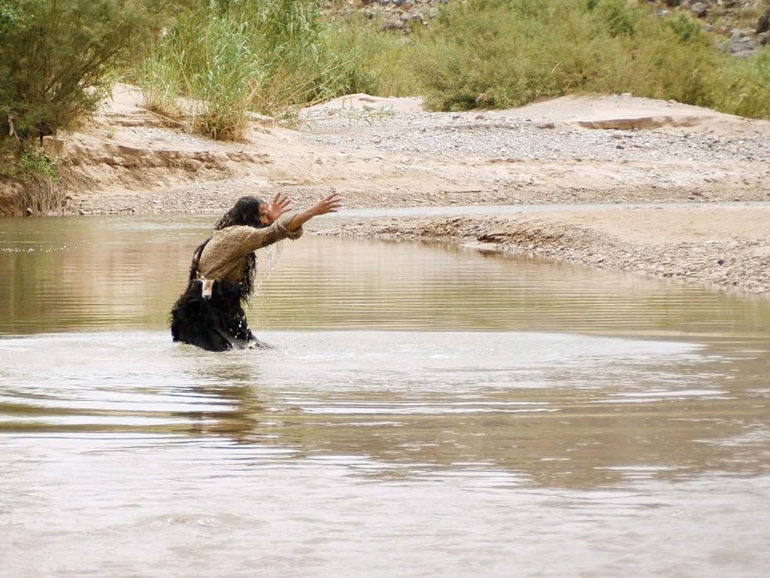

JOHN THE BAPTIST
Matthew 3:1-16
Mark 1:1-11
Luke 3:1-22
John 1:1-34
Free
Bible
images

Slide 36
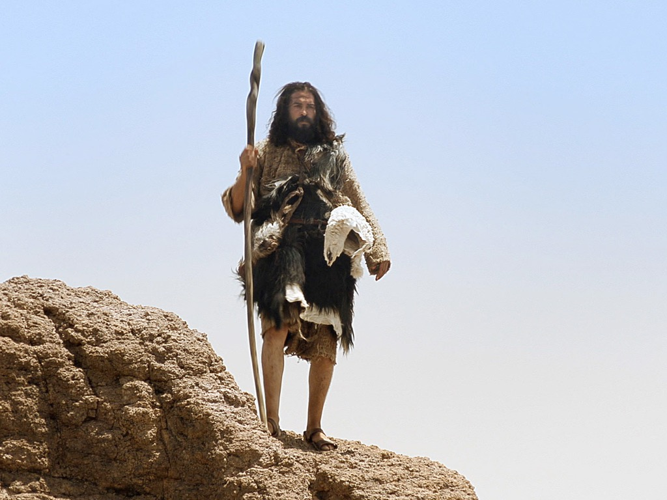

Slide 37
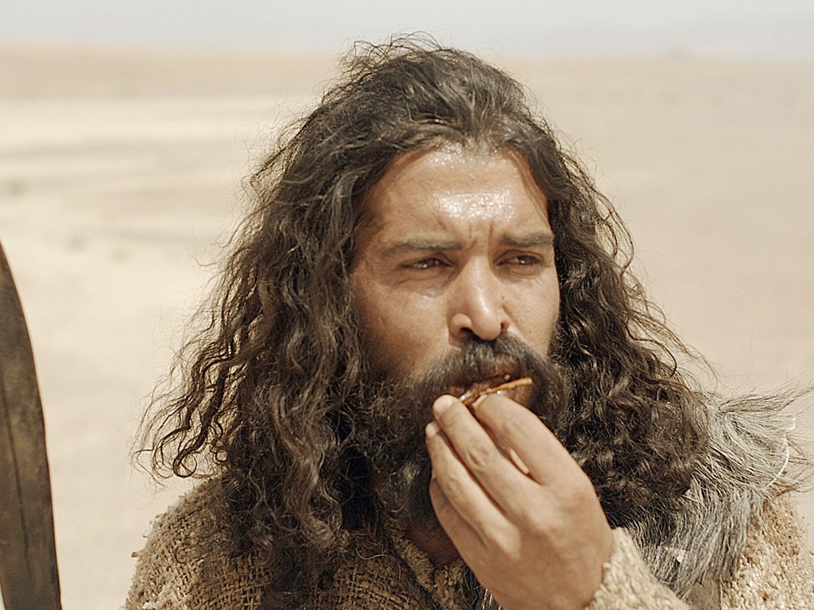

Slide 38
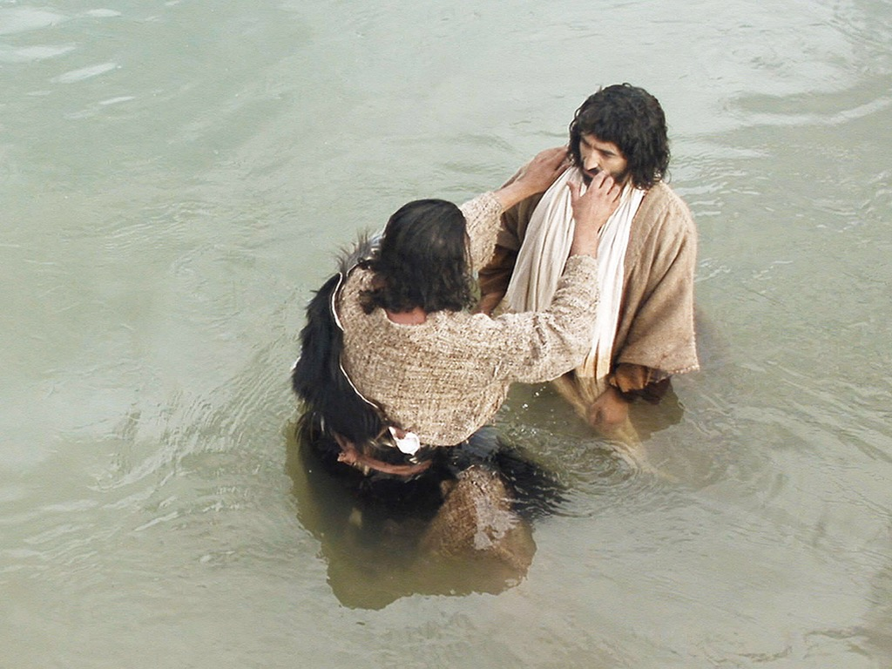

Slide 39
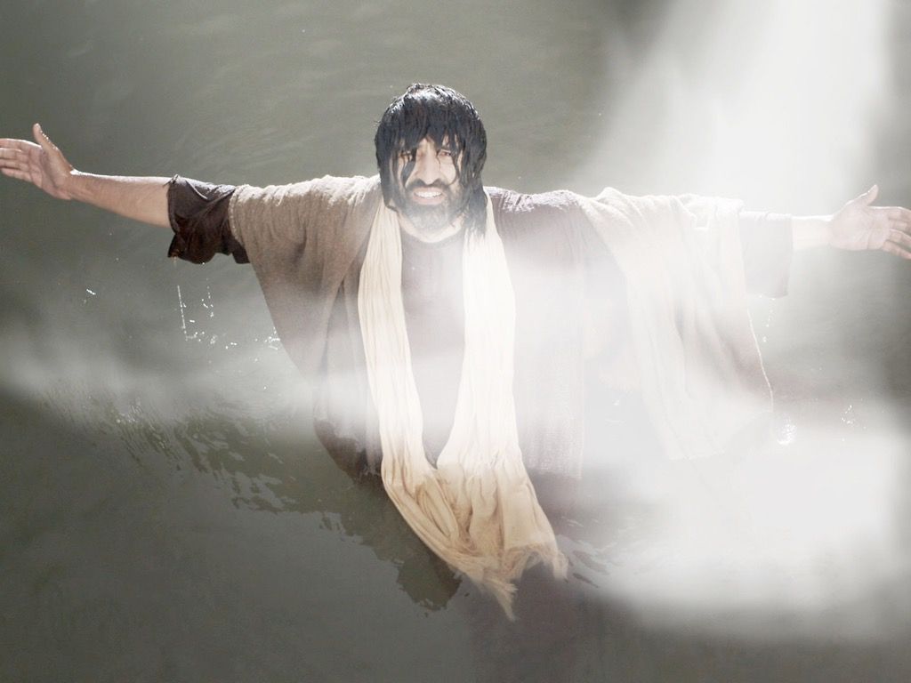

Slide 40

THE WORD IN PICTURES
Free
Bible
images

Slide 41
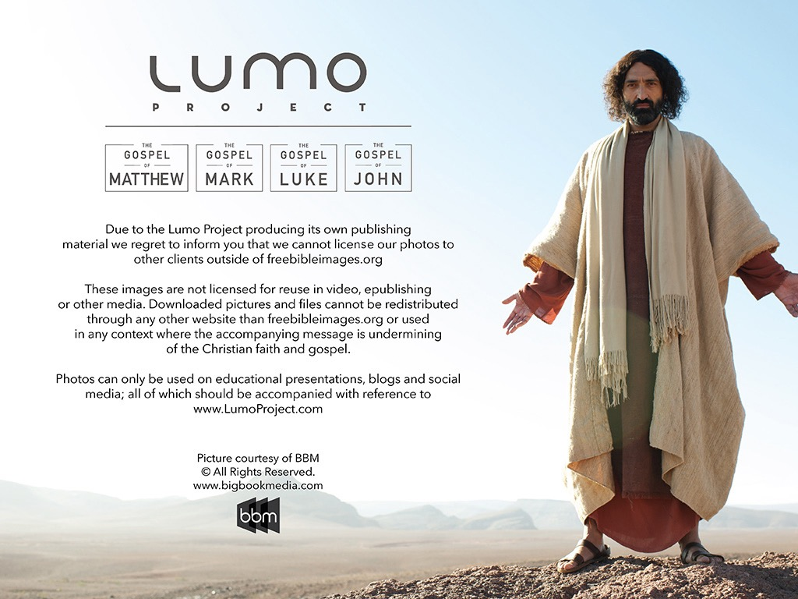
Used with Permission
THE
GOSPEL
——OF—— MATTHEW
THE
GOSPEL
——OF—— MARK
THE
GOSPEL
——OF—— LUKE
THE
GOSPEL
——OF—— JOHN
Due to the Lumo Project producing its own publishing material we regret to inform you that we cannot license our photos to other clients outside of freebibleimages.org.
These images are not licensed for reuse in video, epublishing or other media. Downloaded pictures and files cannot be redistributed through any other website than freebibleimages.org or used in any context where the accompanying message is undermining of the Christian faith and gospel.
Photos can only be used on educational presentations, blogs and social media, all of which should be accompanied with reference to www.LumoProject.com.
Picture courtesy of BBM
© All Rights Reserved.
www.bigbookmedia.com

Slide 42
Slides on
Matthew 5

Slide 43

The Sermon on the Mount
(Matt. 5–7)
Notes:
You may have noticed that my series is called "The Best Sermon Ever." Maybe you thought I had totally lost any sense of humility—but actually, I was referring to Christ's message in Matthew 5–7, which is called "The Sermon on the Mount."

Slide 44
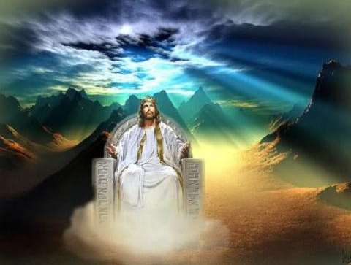
When Jesus is King…
(Matthew 5–7)
What would your life look like if Christ was truly the boss of your life?
Notes:
All of these things support the main teaching of the Sermon that shows what life looks like when Jesus is King of our lives.

Slide 45
Back to Basics (Matt. 5:21-48)
"You have heard that it was said…"
6 Issues:
"But I tell you…"
Murder
Adultery
Divorce
Vows
Revenge
Enemies
God's True Intent
Pharisee Teaching
External purity won't enter the kingdom (20)
Notes:
Here we see how "Jesus rejected the traditions of the Pharisees (vv. 21-48) … Six times Jesus said, "You have heard that it was said. ... But I tell you" (5:21-22, 27-28, 31-32, 33-34, 38-39, 43-44). These words make it clear that Jesus was presenting (a) what the Pharisees and teachers of the Law were saying to the people and, by contrast, (b) what God's true intent of the Law was. This spelled out His statement (v. 20) that Pharisaic righteousness is not enough to gain entrance into the coming kingdom" (Barbieri, BKC, 2:30).

Slide 46
Slides on
Matthew 6

Slide 47
Parallel Structure (Matt 6)
ALMS
(1-4)
PRAYER
(5-15)
FASTING
(16-18)
Hypocrites (2)
Hypocrites (5)
Hypocrites (16)
Public show (1-2)
Public show (5)
Public show (16)
Human
Reward (2)
Human
Reward (5)
Human
Reward (16)
Secret (4)
Secret (6)
Secret (18)
Father sees (4)
Father sees (6, 8)
Father sees (18)
Notes:
Barbieri notes, "In all three examples of Pharisaic 'righteousness'—almsgiving (vv. 1-4), praying (vv. 5-15), and fasting (vv. 16-18)—Jesus spoke of hypocrites (vv. 2, 5, 16), public ostentation (vv. 1-2, 5, 16), receiving their reward in full when their actions are done before men (vv. 2, 5, 16), acting in secret (vv. 4, 6, 18), and being rewarded by the Father, who sees or 'knows,' when one's actions are done secretly (vv. 4, 6, 8, 18)" (Barbieri, BKC, 2:33).

Slide 48
8–10
Outline
73
I. (1:1–4:11) Christ's advent and approvals reveal Him as Messiah and rightful King of Israel.
II. (4:12–7:29) Christ's early ministry and Sermon on the Mount principles reveal Him to have the prophetic ministry expected of the Messiah.
III. (8–10) Christ manifests the power and authority expected of the Messiah to demonstrate His ability to bring the kingdom in if Israel would accept it.

Slide 49
Slides on
Matthew 8

Slide 50
The Power & Authority of Messiah in Matthew 8–10
75
Miracles & Discipleship
(8:1–9:34)
"That evening many demon-possessed people were brought to Jesus. He cast out the evil spirits with a simple command, and he healed all the sick. This fulfilled the word of the Lord through the prophet Isaiah, who said,
'He took our sicknesses
and removed our diseases'"
(Matt. 8:16-17; cf. Isa. 53:4)

Slide 51
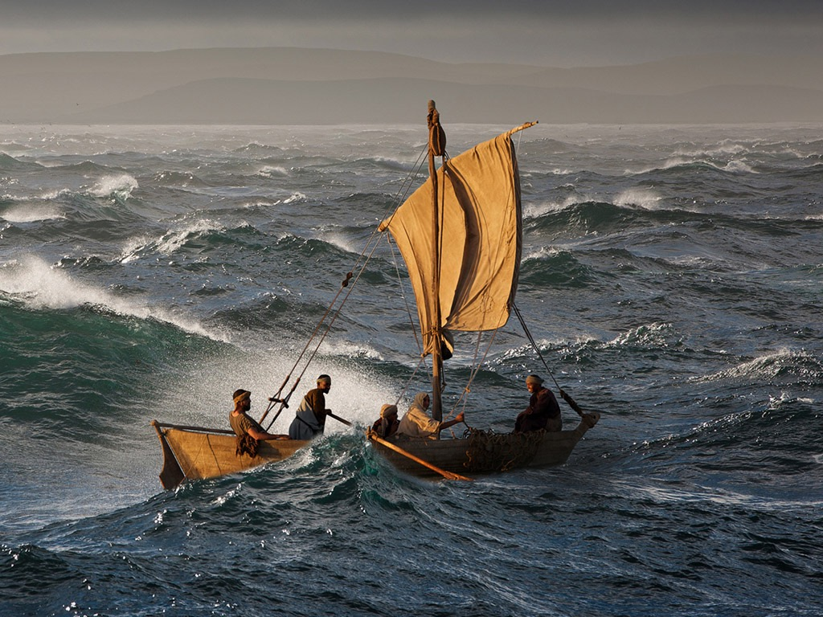

Slide 52
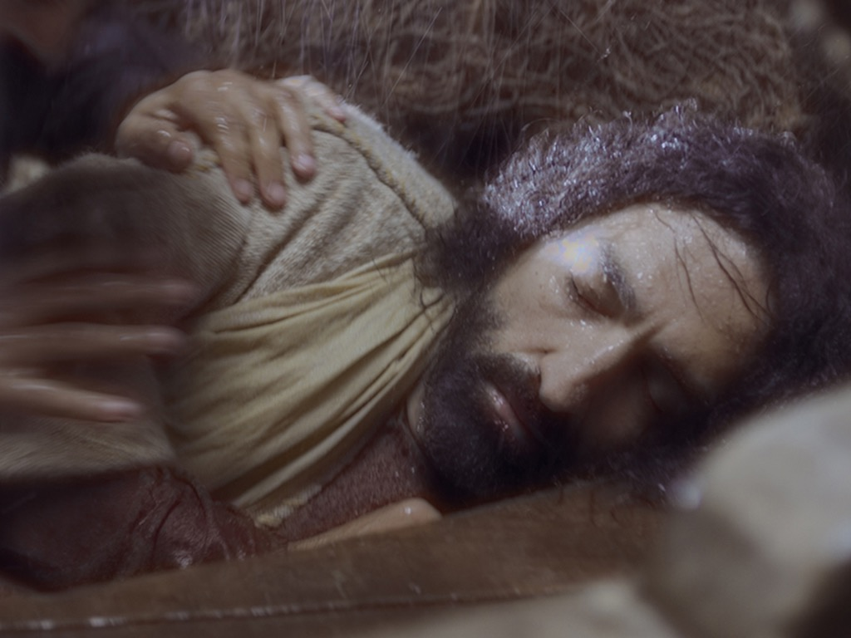

Slide 53
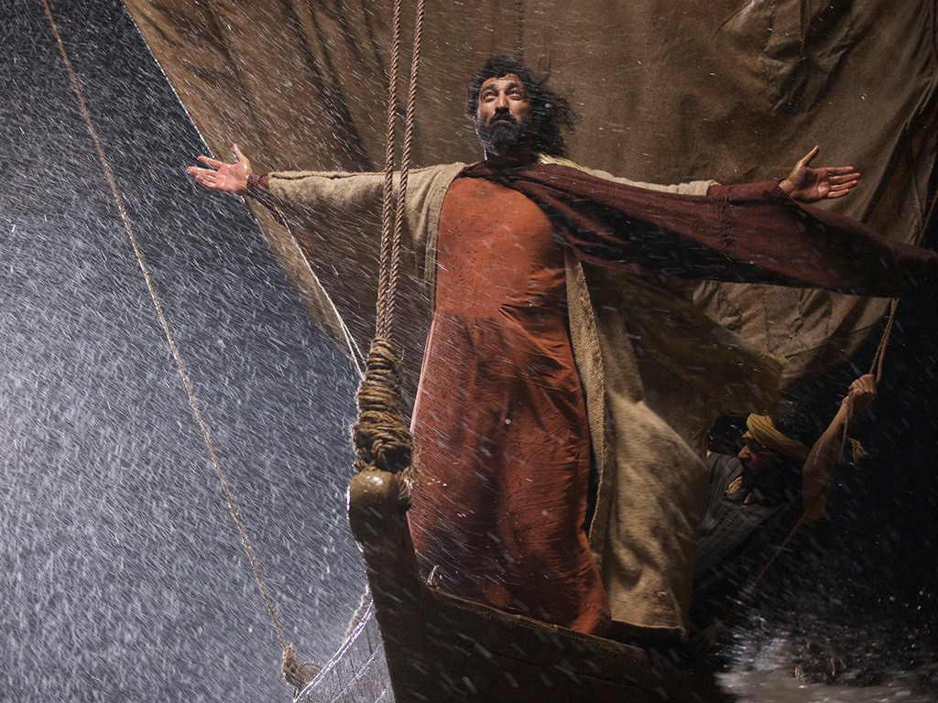

Slide 54


Slide 55
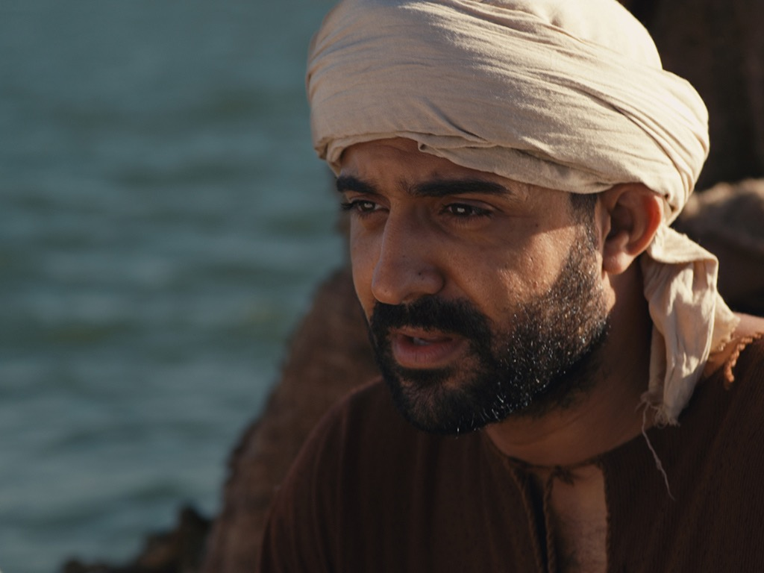

Slide 56
Slides on
Matthew 9

Slide 57
The Power & Authority of Messiah in Matthew 8–10
75
Miracles & Discipleship
(8:1–9:34)
Delegation of Authority to Disciples
(9:35–10:42)
"That evening many demon-possessed people were brought to Jesus. He cast out the evil spirits with a simple command, and he healed all the sick. This fulfilled the word of the Lord through the prophet Isaiah, who said,
'He took our sicknesses
and removed our diseases'"
(Matt. 8:16-17; cf. Isa. 53:4)
"Jesus called his twelve disciples together and gave them authority to cast out evil spirits and to heal every kind of disease and illness"
(Matt. 10:1).

Slide 58
Slides on
Matthew 10

Slide 59
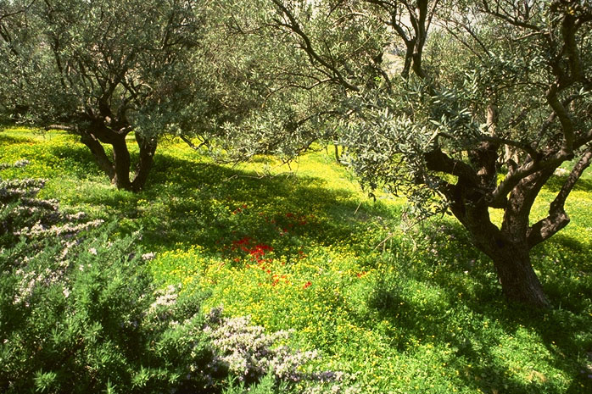
Matt. 10:5-7
"Jesus sent out the twelve apostles with these instructions: 'Don't go to the Gentiles or the Samaritans, ⁶ but only to the people of Israel—God's lost sheep. ⁷ Go and announce to them that the kingdom of heaven is near'"
65
Notes:
What was Jesus saying to us? In Matthew's fourth chapter, we are told that "Jesus began to preach and say: 'Repent, for the kingdom of heaven is at hand…Jesus was going throughout all Galilee, teaching in their synagogues and proclaiming the gospel of the Kingdom…'"
What is that Kingdom? What did he mean?

Slide 60
Why serve Jesus?

Slide 61
Amazing Names
Jesus is the highest ruler in the world (Matt 1–10).
Christ
Notes:
[Jesus met every prophecy we should expect for him to prove he is King.]
[Christ means Messiah-Ruler, for he fulfilled each part of his job description.]
—What more would Christ need to do for you to trust him with your life?
—Have you been the victim of Christ’s first mistake? How?
—Do you see how statistically unlikely it was for Jesus to be the Messiah?

Slide 62
Amazing Names
Jesus is the highest authority in the Church (Matt 11–27).
Lord
Christ
Notes:
[As Master, he is the boss of every believer’s life.]
What do we mean when we say, “Jesus is Lord”? The Greek word for “lord” is kurios, which refers to “1. one who is in charge by virtue of possession, owner” or “2. one who is in a position of authority, lord, master” (BDAG 577). Jesus as “Lord” means that he is in charge as the ultimate authority. His authority comes as owner of this world and no position is higher than his as God.
This got the early Christians into trouble. Rome recognized the emperor as the highest authority, and in the reigns of Caligula, Nero and Domitian, loyal citizens worshipped the emperor as a god. However, believers in the lordship of Christ could worship no other god. As they recognized no higher authority, and as we remember the humility of Jesus laid in a manger this Christmas season, let us not forget that this same Jesus is indeed the highest authority of all. Don’t be fooled by his quiet entrance into our world with the weaknesses of a baby. He alone is Lord.

Slide 63
Slides on
Matthew 11

Slide 64
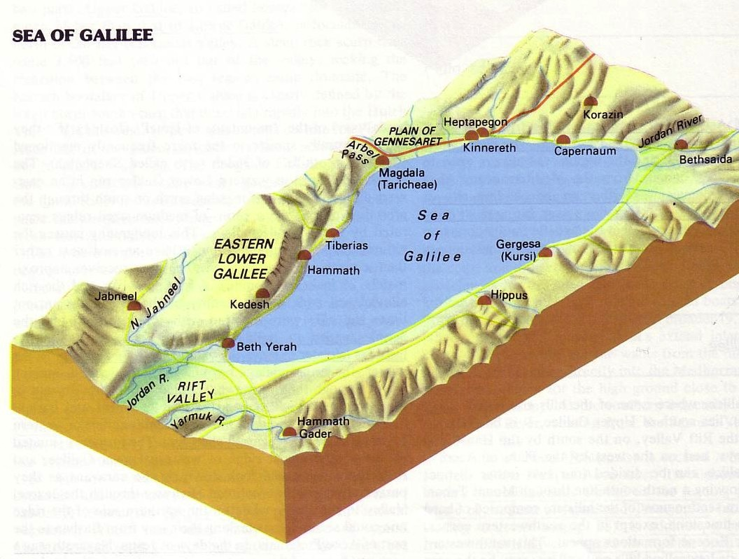

The Tri-City Area
172
Point f
Then Jesus began to denounce the cities in which most of his miracles had been performed, because they did not repent.
"Woe to you, Korazin! Woe to you Bethsaida!
If the miracles that were performed in you had been performed in Tyre and Sidon, they would have repented long ago in sackcloth and ashes. But I tell you, it will be more bearable for Tyre and Sidon on the day of judgment than for you.
And you, Capernaum, will you be lifted up to the skies? … It will be more bearable for Sodom on the day of judgment than for you."
Matthew 11:20-24

Slide 65
Slides on
Matthew 12

Slide 66
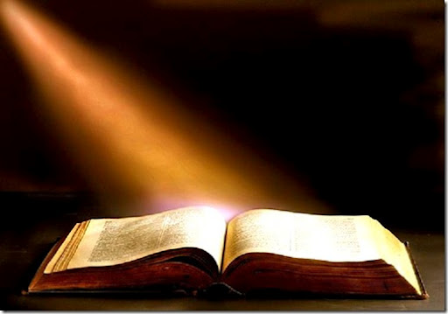
The Context of the Text
xiv
Christ healed a blind/mute (Matt. 12:22)
The crowds claimed, "He's Messiah!"
The Pharisees said, "He's demonic!"
Jesus gave a threefold response (12:25-29)

Slide 67
Slides on
Matthew 13

Slide 68
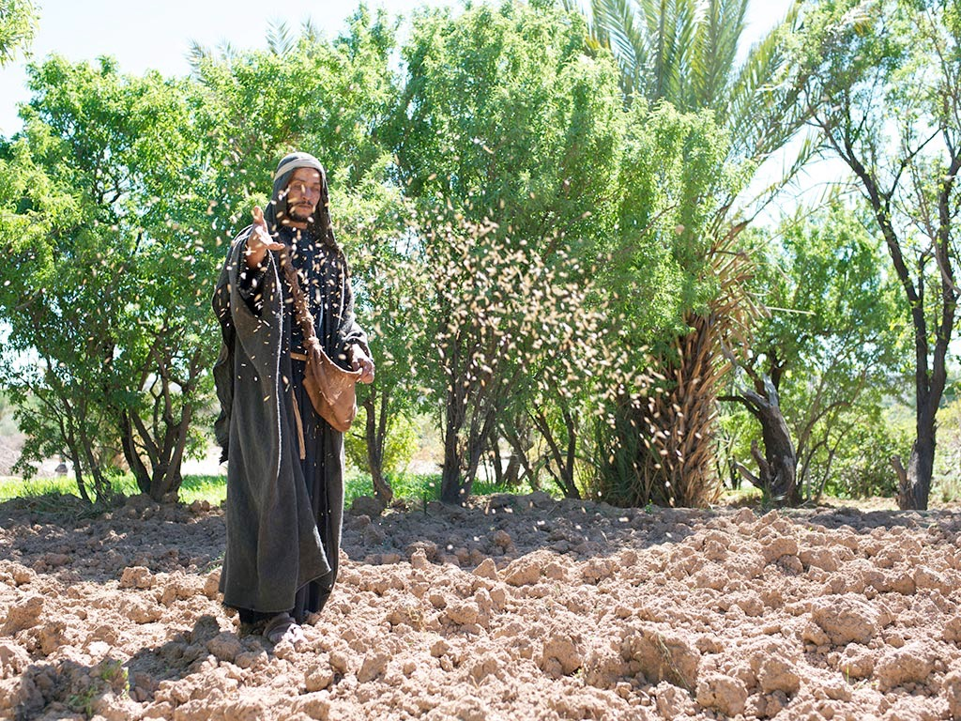

Matthew 13:1-23; Mark 4:1-20; Luke 8:1-15
PARABLE OF THE SOWER

Slide 69
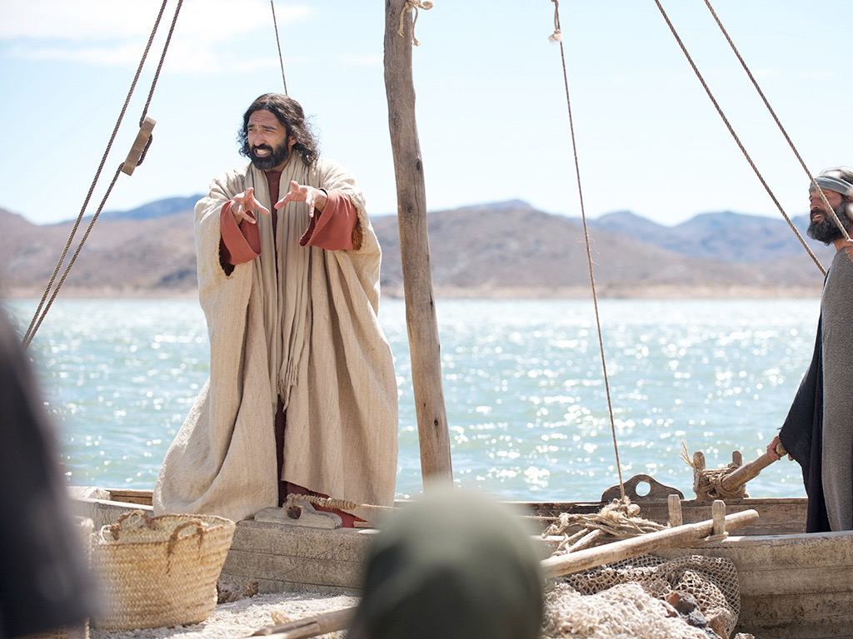

Slide 71
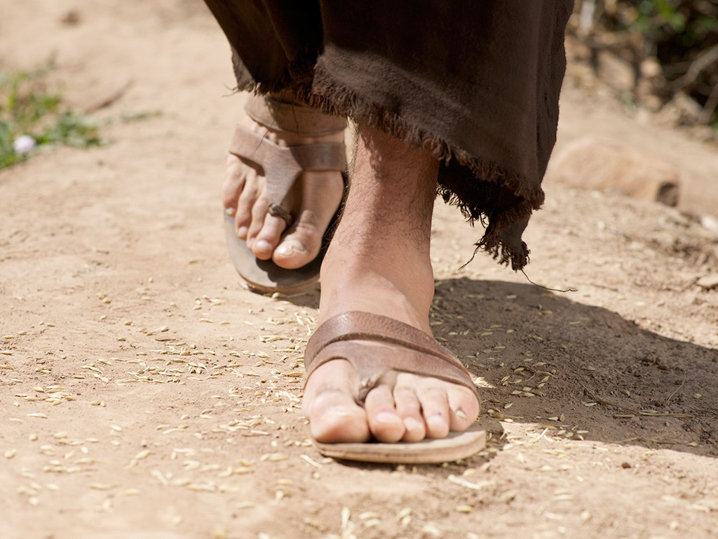

Slide 72
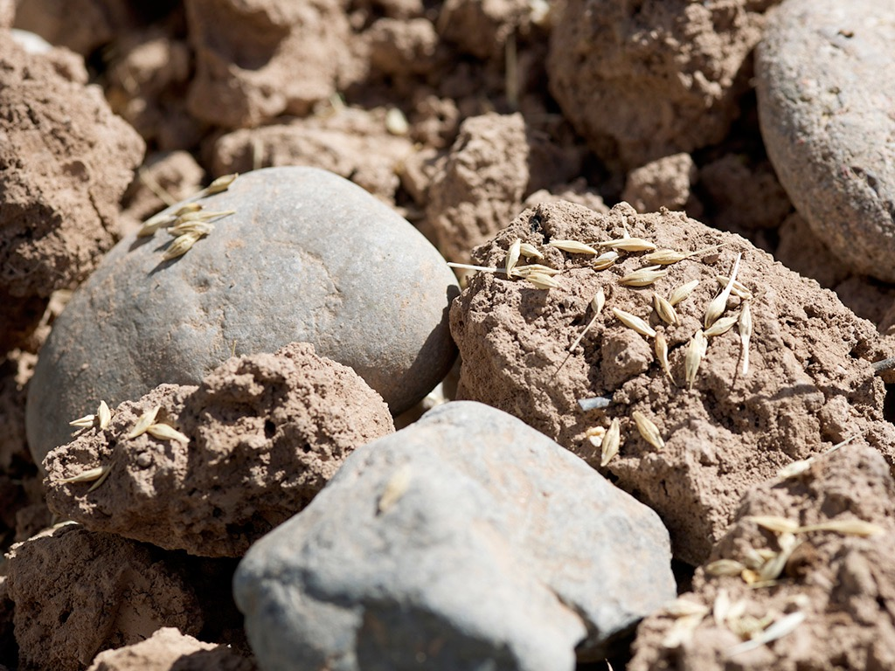

Slide 73


Slide 74
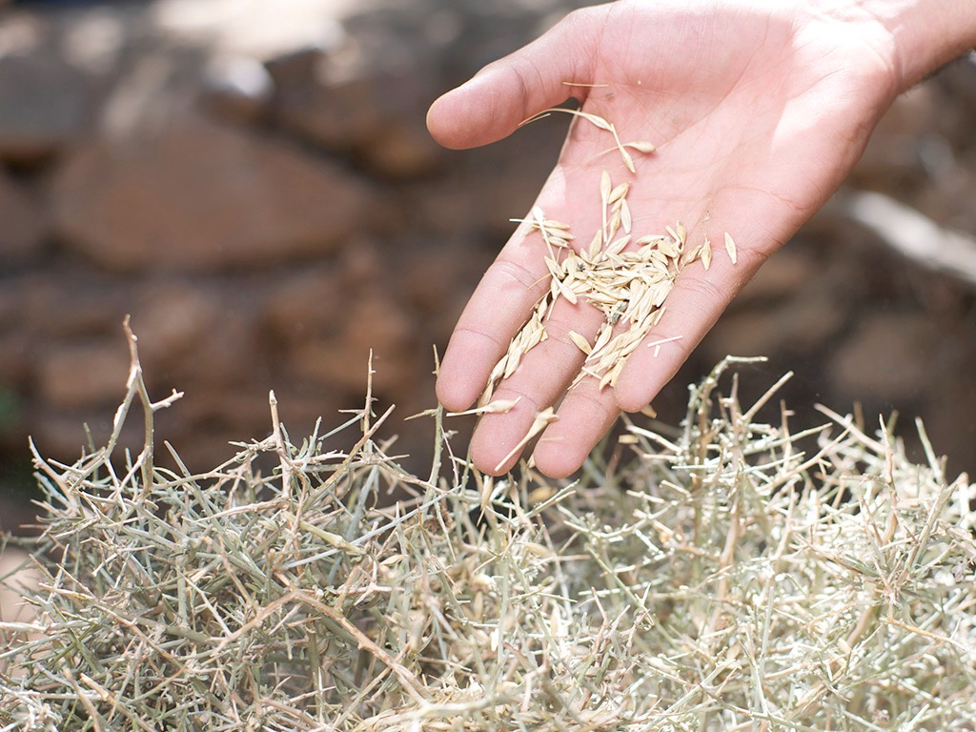

Slide 75
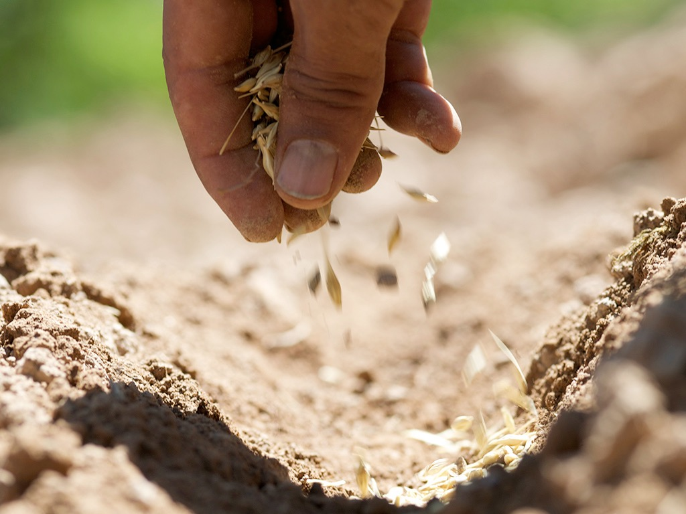

Slide 76
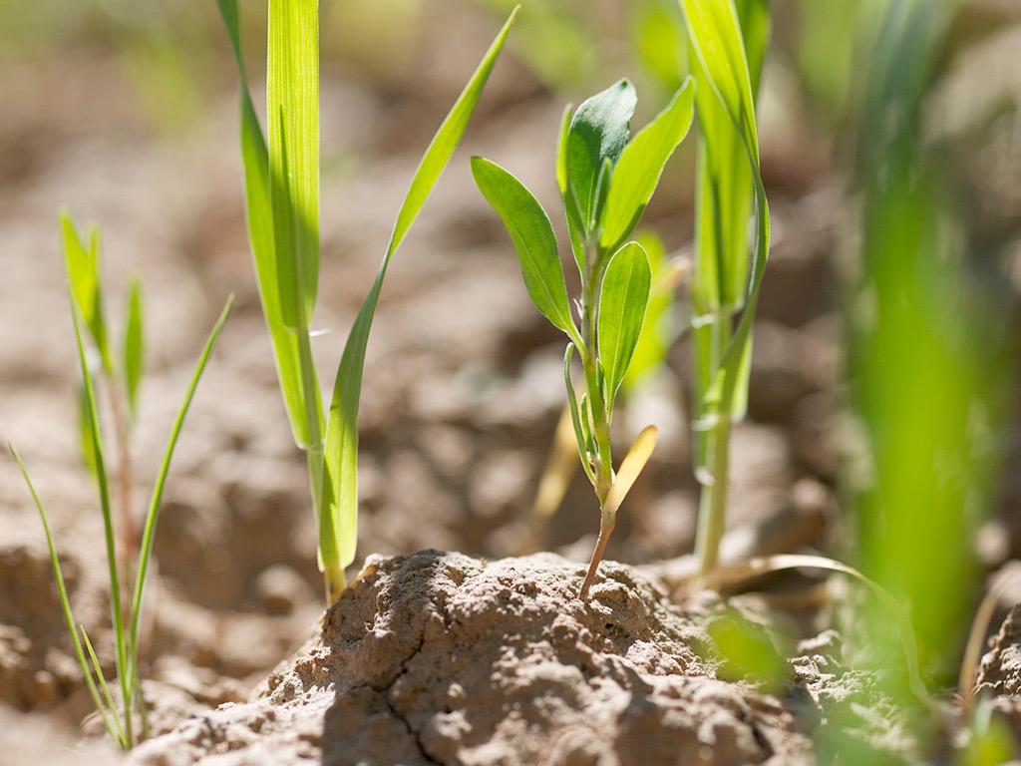

Slide 77
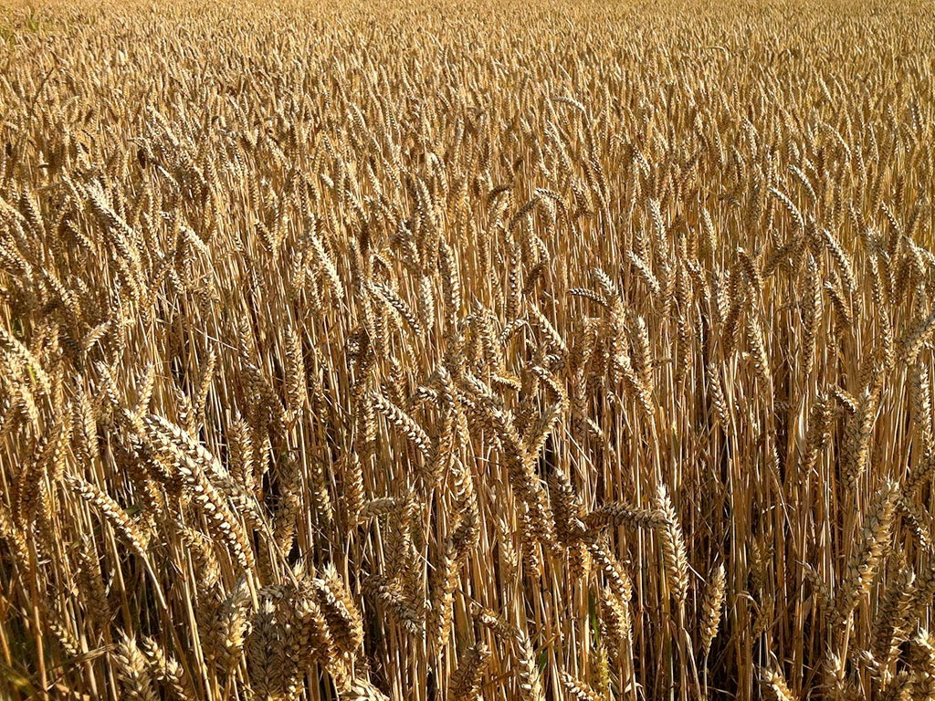

Slide 78
The Interadvent Age
76
First Advent
Second Advent
Second
=
Coming
Interadvent Age
(Church Age)
Millennium
Eternal Kingdom
1000 years
Judgment
Judgment

Slide 79
Slides on
Matthew 14

Slide 80
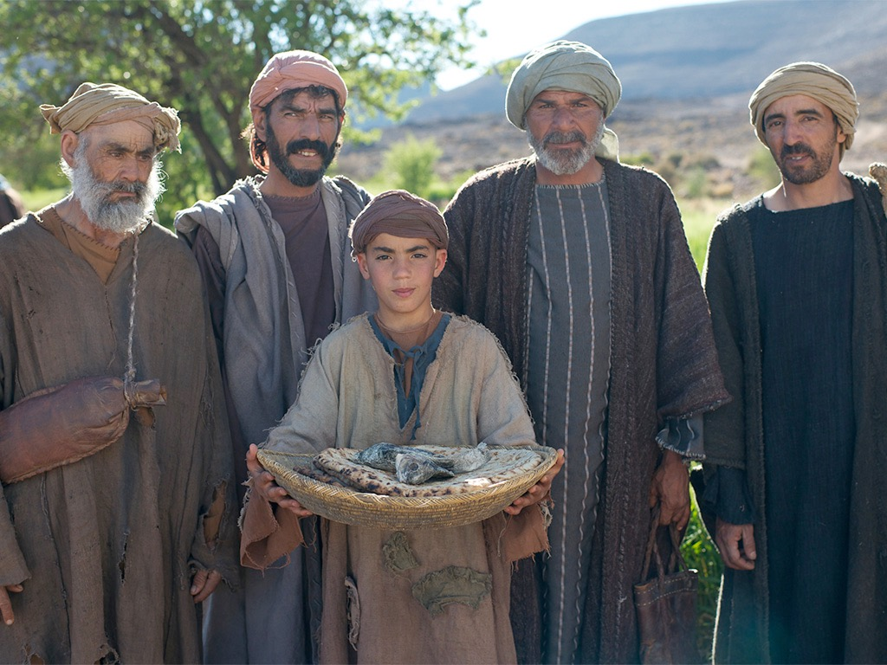

Slide 81


Slide 82


Slide 83


Slide 84


Slide 85
Slides on
Matthew 18

Slide 86
Matthew 18:15-20
If your brother sins against you, go and show him his fault, just between the two of you. If he listens to you, you have won your brother over. ¹⁶But if he will not listen, take one or two others along, so that 'every matter may be established by the testimony of two or three witnesses.' ¹⁷If he refuses to listen to them, tell it to the church; and if he refuses to listen even to the church, treat him as you would a pagan or a tax collector.
¹⁸I tell you the truth, whatever you bind on earth will be bound in heaven, and whatever you loose on earth will be loosed in heaven. ¹⁹Again, I tell you that if two of you on earth agree about anything you ask for, it will be done for you by my Father in heaven. ²⁰For where two or three come together in my name, there am I with them.
How to Restore
15-17
Why to Restore
18-20
Notes:
In Matthew 18:15-20 Jesus provides God's plan for loving church discipline. Let's read it together [read 15-20.] This text has two main teachings on restoring Christians in sin.
• Verses 15-17 give how to restore them and…
• Verses 18-20 give why to restore them.
Let's first see how to restore relationships. God's way to restore believers in sin is to…

Slide 87

Main Idea:
We must restore sinning members properly since we act on God's behalf
Notes:
When sheep stray, we shepherd them back as loving hands of God's grace.

Slide 88
Slides on
Matthew 21

Slide 89


Slide 90


Slide 91


Slide 92


Slide 93


Slide 94


Slide 95
Slides on
Matthew 24

Slide 96

Disciples: What a fantastic temple! (24:1)
Jesus: "Not one stone here will be left on another" (24:2)
Disciples: When? What sign? (24:3)

Slide 97

The Olivet Discourse (Matthew 24–25)
77
Adapted from Mark L. Bailey, DTS class notes, 1986
Second Coming (27-31):
Signs in the Heavens (29-30)
Coming of the Son of Man (27, 30)
Bird Supper (28)
Salvation of Elect (31)
Abomination of Desolation
(15-20)
False Christs
& Prophets
(23-26)
Beginning of Birth Pangs
(4-8)
Great Tribulation
(9-14, 21-22)
Judgment of the Nations
Sheep
Goats
Correlation with Revelation
12:7-12
13:14
12:8-17
8:1–19:10
(Matt. 25:31-46)
6:1–8:5
19:11-21

Slide 98
Slides on
Matthew 25

Slide 99


Aren't Sheep & Goats the Same?

Slide 100

Judgment of the Nations
"All the nations will be gathered in his presence, and he will separate the people as a shepherd separates the sheep from the goats. ³³He will place the sheep at his right hand and the goats at his left"
(Matt. 25:31-32).

Slide 101

Judgment of Living Gentiles
⁴¹ "Then the King will turn to those on the left and say, 'Away with you, you cursed ones, into the eternal fire prepared for the devil and his demons. ⁴² For I was hungry, and you didn't feed me. I was thirsty, and you didn't give me a drink.
⁴³ I was a stranger, and you didn't invite me into your home. I was naked, and you didn't give me clothing. I was sick and in prison, and you didn't visit me.'
⁴⁴ "Then they will reply, 'Lord, when did we ever see you hungry or thirsty or a stranger or naked or sick or in prison, and not help you?'
⁴⁵ "And he will answer, 'I tell you the truth, when you refused to help the least of these my brothers and sisters, you were refusing to help me.' ⁴⁶ "And they will go away into eternal punishment, but the righteous will go into eternal life" (Matt. 25:41-46 NLT).

Slide 102
Slides on
Matthew 26

Slide 103


Slide 104


Slide 105


Slide 106


Slide 107


Slide 108


Slide 109


Slide 110


Slide 111


Slide 112


Slide 113


Slide 114


Slide 115


Slide 116


Slide 117


Slide 118


Slide 119


Slide 120


Slide 121


Slide 122


Slide 123


Slide 124


Slide 125


Slide 126
Why serve Jesus?

Slide 127
Amazing Names
Jesus is the highest ruler in the world (Matt 1–10).
Christ
Notes:
[Jesus met every prophecy we should expect for him to prove he is King.]
[Christ means Messiah-Ruler, for he fulfilled each part of his job description.]
—What more would Christ need to do for you to trust him with your life?
—Have you been the victim of Christ’s first mistake? How?
—Do you see how statistically unlikely it was for Jesus to be the Messiah?

Slide 128
Amazing Names
Jesus is the highest authority in the Church (Matt 11–27).
Lord
Christ
Notes:
[As Master, he is the boss of every believer’s life.]
As a Christian, do you recognize Christ’s authority over you?
—Why do you do what you do in terms of your life work?
—How did you make that decision?
—What area of your life right now should you submit to his authority?

Slide 129
Amazing Names
Lord
Jesus
Christ
Jesus provided salvation by conquering death (Matt 28).
Notes:
[He lived up to his name and proved he could save us by rising from the grave.]
What about the name “Jesus”? When announcing his soon birth to Joseph, the angel declared, “…you are to name him Jesus, for he will save his people from their sins” (Matt 1:21b). This verse confuses most of us. We know his name is Jesus, but we don’t see the connection to the next phrase, “for he will save…”
Actually, the link is very direct. “Jesus” simply means “Saviour,” so the verse actually means, “…you are to name him Saviour, for he will save his people from their sins.” Now that makes sense. The name comes from “Jeshua,” which was a later form for “Joshua” (BDAG 472). As Joshua delivered Israel from the enemies in Canaan, so Jesus delivers us from sin itself. Calling him “Jesus” points to his later atoning work on the cross where our sins were forgiven.

Slide 130
Slides on
Matthew 28

Slide 131


Slide 132


Slide 133


Slide 134


Slide 135


Slide 136


Slide 137


Guards Bribed (28:12)

Slide 138


The Great Commission
Matthew 28:18-20
¹⁸Then Jesus came to them and said, "All authority in heaven and on earth has been given to me. ¹⁹Therefore go and make disciples of all nations, baptizing them in the name of…, ²⁰and teaching them to obey everything I have commanded you. And surely I am with you always, to the very end of the age."
Notes:
Christ has all authority but he extends some of it to us as people under his authority. It may appear that there are four commands here, but "make disciples" is the only command here. This happens by us also obeying the three participles: going, baptizing, and teaching.

Slide 139
The Great Commission
Make Disciples
Going
Baptizing
Teaching
Salvation
Identification
Sanctification
Evangelism
Assimilation
Education
Believing
Bonding
Maturing
Find Them
Keep Them
Build Them
Adapted from Dr. Gary McIntosh, Church Growth Network 2014
Notes:
Most churches emphasize the third column and think only of teaching as discipleship; However, it includes going, baptizing, and teaching.
List the ministries in your church under their appropriate column. If it can't be listed under one of these, then eliminate that ministry.
Which of the three columns is weakest in your church? What can you do to strengthen this weak area?

Slide 140
Amazing Names
Lord
Jesus
Christ
Jesus provided salvation by conquering death (Matt 28).
Notes:
[He lived up to his name and proved he could save us by rising from the grave.]
What about the name “Jesus”? When announcing his soon birth to Joseph, the angel declared, “…you are to name him Jesus, for he will save his people from their sins” (Matt 1:21b). This verse confuses most of us. We know his name is Jesus, but we don’t see the connection to the next phrase, “for he will save…”
Actually, the link is very direct. “Jesus” simply means “Saviour,” so the verse actually means, “…you are to name him Saviour, for he will save his people from their sins.” Now that makes sense. The name comes from “Jeshua,” which was a later form for “Joshua” (BDAG 472). As Joshua delivered Israel from the enemies in Canaan, so Jesus delivers us from sin itself. Calling him “Jesus” points to his later atoning work on the cross where our sins were forgiven.

Slide 141
Why serve Jesus?

Slide 142
MAIN IDEA OF MATTHEW
Serve the Lord Jesus Christ
Lord
Jesus
Christ
Notes:
Serve Jesus as Savior, God, and King of your life!

Slide 143
Amazing Names
Jesus is the highest ruler in the world (Matt 1–10).
Christ
Notes:
[Jesus met every prophecy we should expect for him to prove he is King.]
[Christ means Messiah-Ruler, for he fulfilled each part of his job description.]
—What more would Christ need to do for you to trust him with your life?
—Have you been the victim of Christ’s first mistake? How?
—Do you see how statistically unlikely it was for Jesus to be the Messiah?

Slide 144
Amazing Names
Jesus is the highest authority in the Church (Matt 11–27).
Lord
Christ
Notes:
[As Master, he is the boss of every believer’s life.]
As a Christian, do you recognize Christ’s authority over you?
—Why do you do what you do in terms of your life work?
—How did you make that decision?
—What area of your life right now should you submit to his authority?

Slide 145
Amazing Names
Lord
Jesus
Christ
Jesus provided salvation by conquering death (Matt 28).
Notes:
[He lived up to his name and proved he could save us by rising from the grave.]
What impact does Christ’s resurrection have on you personally?
—Do you believe Jesus really came back from the dead?
—Have you ever sincerely studied the resurrection?
—Are you one of those disciples noted in Matthew 28:19?
—How can you better make disciples? Who should you disciple?

Slide 146
MAIN IDEA OF MATTHEW
Serve the Lord Jesus Christ
GOD
Lord
KING
Jesus
Christ
SAVIOR
Notes:
Serve Jesus as Savior, God, and King of your life!
One core value of our church is to be context-relevant. We present the unchanging Lord Jesus Christ to our ever-changing world because no one is more relevant than him. How do we do this? We proclaim that he is the ultimate authority as God (Lord), yet took on humanity to save us from our sins (Jesus) and will rule over all (Christ).

Slide 147


Do you trust the King right now?
Before we can pray, "Lord, Thy kingdom come," we must be willing to pray, "My kingdom go."
Matthew
Notes:
What is holding you back in your own kingdom before you can embrace Christ’s kingdom?
Your career?
Trusting God to meet your financial needs?
A relationship?
Can you tell him now that you want his kingdom instead of your own?

Slide 148
Black

Slide 149


NT Preaching • BibleStudyDownloads.org
Get this presentation and script for free!

