Slide 1
TB Progress update and action plan (including COVID-19 mitigation) to achieve Y2
NTC 9 DecEMBER 2021

Slide 2
Content
1. NTP strategy
2. Current Progress and Challenges
3. Coordination and cooperation from others development partners to further support NTCP achieving the strategy

Slide 3
1. NTP strategy 2021-2025 (1)
Vision: END TB in Lao PDR
Objectives:
To decrease mortality and morbidity due to TB as per End TB targets milestones (50% reduction in TB incidence and 75% reduction in mortality due to TB by 2025 compared to 2015)
To develop patient centred approach and equity in access to quality TB services
To protect all TB patients under the National Health insurance system
To contribute to the Universal Health Coverage (quality TB services in primary health care at province, district and health centre levels)

Slide 4
1. NTP strategy 2021-2025 (2)
Increase awareness and access for all TB patients from village to health centre level with community based approaches/partners;
Tested for resistance to Rifampicin all TB presumptive using Xpert;
Free screening by chest X-ray to all TB contacts;
ACF among high risk groups;
Streamline TB and HIV collaborative activities within UHC;
Real time surveillance with DHIS 2 TB tracker countrywide;
PHO/DHO analyse reports in DHIS2 and adapt interventions;
NHI coverage and social support to all TB/MDR-TB patients;

Slide 5
3. Coordination and cooperation from others development partners to achieve the strategy
NTC is ensuring regular coordination and cooperation with:
Central level:
DPC, DCDC, DHR, FDD, National Nutrition Centre, NCLE, Health Education Centre, MPSC, NTC, CHAS Ministry of labour and social welfare (NHI bureau), Department of Security, Trade Union, Lao Women Union, Youth Union;
Provincial and district levels: PHOs and DHOs, all hospitals (central, province, district) and all health centres;
VHWs, VHVs at community level country wide
Community based partners in selected ares: CHIAS, PEDA, HPP
Other partners:
Global Fund, World Bank, private sector, international technical partners (WHO, CHAI, CILM, KIT)

Slide 6
2. Current progress and challenges (1)
DLI-J | Y2 (Jun 2021 to May 2022)
 | Target June 2021-May 2022 | Preliminary Result Jun.-Nov. 2021 | % of target for the reported period
TB notification # | 7,537 TB cases notified for the period of Jun/21-May 2022 for the whole country | 2,574 TB cases notified during the period of Jun-Nov 2021 (source TB tracker DHIS2) | 68%
Xpert coverage % | 100% for the period of Jun/21-May 2022 for the whole country | 99% in 2021 (source: aggregated quarterly report in DHIS2 Q1-Q3 2021) | 99%

Slide 7
DLI J Condition1:Provinces that achieved the targeted number of notified TB cases of all forms
No. | Provinces | Baseline | 2021 |  |  |  |  |  |  | 2022 |  |  |  |  | Total | Target | Progress | % of target for the reported period
 |  |  | Jun | Jul | Aug | Sep | Oct | Nov | Dec | Jan | Feb | Mar | Apr | May
1 | 01 Vientiane Capital | 1,524 | 93 | 102 | 128 | 84 | 49 | 8 |  |  |  |  |  |  | 464 | 990 | 46% | 94%
2 | 02 Phongsali | 189 | 7 | 10 | 11 | 11 | 5 | 1 |  |  |  |  |  |  | 45 | 203 | 22% | 44%
3 | 03 Louangnamtha | 219 | 20 | 14 | 17 | 21 | 14 | 1 |  |  |  |  |  |  | 87 | 201 | 43% | 87%
4 | 04 Oudomxai | 334 | 31 | 23 | 29 | 24 | 30 | 1 |  |  |  |  |  |  | 138 | 365 | 37% | 76%
5 | 05 Bokeo | 169 | 5 | 15 | 19 | 13 | 4 | 1 |  |  |  |  |  |  | 57 | 202 | 28% | 56%
6 | 06 Louangphabang | 379 | 22 | 23 | 83 | 11 | 7 | 1 |  |  |  |  |  |  | 147 | 509 | 28% | 58%
7 | 07 Houaphan | 277 | 12 | 50 | 3 | 7 | 2 | 1 |  |  |  |  |  |  | 75 | 358 | 20% | 42%
8 | 08 Xainyabouli | 216 | 16 | 21 | 14 | 15 | 8 |  |  |  |  |  |  |  | 74 | 420 | 17% | 35%
9 | 09 Xiangkhouang | 84 | 1 | 3 | 4 | 3 | 4 |  |  |  |  |  |  |  | 15 | 224 | 6% | 13%
10 | 10 Vientiane | 439 | 15 | 15 | 197 | 19 | 8 | 2 |  |  |  |  |  |  | 256 | 566 | 45% | 90%
11 | 11 Bolikhamxai | 194 | 11 | 56 | 26 | 14 | 8 | 3 |  |  |  |  |  |  | 118 | 325 | 36% | 73%
12 | 12 Khammouan | 577 | 45 | 110 | 28 | 9 | 18 | 8 |  |  |  |  |  |  | 218 | 457 | 47% | 95%
13 | 13 Savannakhet | 1,190 | 50 | 37 | 37 | 45 | 21 | 57 |  |  |  |  |  |  | 247 | 1,116 | 22% | 44%
14 | 14 Salavan | 497 | 27 | 77 | 92 | 25 | 15 | 11 |  |  |  |  |  |  | 247 | 447 | 55% | 111%
15 | 15 Xekong | 209 | 4 | 2 | 8 | 5 | 7 |  |  |  |  |  |  |  | 26 | 126 | 20% | 41%
16 | 16 Champasak | 954 | 76 | 61 | 60 | 64 | 40 | 21 |  |  |  |  |  |  | 322 | 810 | 39% | 80%
17 | 17 Attapu | 94 | 5 | 9 |  | 4 |  |  |  |  |  |  |  |  | 18 | 159 | 11% | 23%
18 | 18 Xaisomboun | 18 |  | 1 | 1 | 17 | 1 |  |  |  |  |  |  |  | 20 | 60 | 33% | 67%
Total |  | 7,565 | 440 | 629 | 757 | 391 | 241 | 116 | 0 | 0 | 0 | 0 | 0 | 0 | 2,574 | 7,537 | 34% | 68%

Slide 8
DLI J condition 2:Provinces which have achieved an increase of twenty (20) percentage points over the previous year; or reached or maintained one hundred percent (100%) GeneXpert coverage
No | Provinces | Baseline | 2021 |  |  |  |  |  |  |  |  | Tatal
 |  |  | Q1 (Jan – Mar) |  |  | Q2 (Apr – Jun) |  |  | Q3 (Jul – Sep)
 |  |  | No. of Xpert Test | No. of TT of SC | % | No. of Xpert Test | No. of TT of SC | % | No. of Xpert Test | No. of TT of SC | % | No. of Xpert Test | No. of TT of SC | %
1 | 01 Vientiane Cap | 92% | 2818 | 2819 | 100% | 1832 | 1861 | 98% | 2478 | 2505 | 99% | 7128 | 7185 | 99%
2 | 02 Phongsaly | 70% | 142 | 142 | 100% | 217 | 217 | 100% | 146 | 146 | 100% | 505 | 505 | 100%
3 | 03 Louangnamtha | 77% | 528 | 528 | 100% | 252 | 254 | 99% | 309 | 311 | 99% | 1089 | 1093 | 100%
4 | 04 Oudomxai | 33% | 608 | 608 | 100% | 260 | 260 | 100% | 469 | 469 | 100% | 1337 | 1337 | 100%
5 | 05 Bokeo | 49% | 199 | 199 | 100% | 39 | 44 | 89% | 233 | 233 | 100% | 471 | 476 | 99%
6 | 06 Louangphabang | 65% | 454 | 454 | 100% | 346 | 367 | 94% | 552 | 558 | 99% | 1352 | 1379 | 98%
7 | 07 Houaphan | 75% | 306 | 306 | 100% | 312 | 312 | 100% | 463 | 463 | 100% | 1081 | 1081 | 100%
8 | 08 Xainyabouli | 71% | 479 | 517 | 93% | 351 | 351 | 100% | 391 | 391 | 100% | 1221 | 1259 | 97%
9 | 09 Xiangkhouang | 83% | 344 | 351 | 98% | 107 | 107 | 100% | 230 | 235 | 98% | 681 | 693 | 98%
10 | 10 Vientiane Pro | 79% | 476 | 488 | 98% | 358 | 359 | 100% | 808 | 819 | 99% | 1642 | 1666 | 99%
11 | 11 Bolikhamxai | 68% | 209 | 224 | 93% | 192 | 201 | 96% | 486 | 486 | 100% | 887 | 911 | 97%
12 | 12 Khammouan | 72% | 668 | 668 | 100% | 531 | 536 | 99% | 741 | 741 | 100% | 1940 | 1945 | 100%
13 | 13 Savannakhet | 60% | 913 | 913 | 100% | 667 | 668 | 100% | 927 | 927 | 100% | 2507 | 2508 | 100%
14 | 14 Salavan | 56% | 1574 | 1576 | 100% | 333 | 334 | 100% | 592 | 593 | 100% | 2499 | 2503 | 100%
15 | 15 Sekong | 81% | 267 | 275 | 97% | 100 | 156 | 64% | 82 | 91 | 90% | 449 | 522 | 86%
16 | 16 Champasak | 95% | 1069 | 1069 | 100% | 803 | 803 | 100% | 1039 | 1039 | 100% | 2911 | 2911 | 100%
17 | 17 Attapue | 73% | 193 | 193 | 100% | 100 | 100 | 100% | 85 | 85 | 100% | 378 | 378 | 100%
18 | 18 Xaisomboun | 72% | 90 | 100 | 90% | 17 | 32 | 53% | 63 | 86 | 73% | 170 | 218 | 78%
Total |  | 74% | 11337 | 11430 | 99% | 6817 | 6962 | 98% | 10094 | 10178 | 99% | 28248 | 28570 | 99%

Slide 9
2. Current progress and challenges (2)
CHALLENGES
ActionS taken
Drop in TB notification is due to:
Drop in sending sputum specimen to Xpert testing
Limited access of the patient to health facility.
Limitation of activities due to COVID19 lockdown.
Implementation at BMU not well functioned due to Covid situation.
Limitation and re-tasking of human resource at all levels, particularly district hospital.
Many activities were not implemented including active case-finding.
NTC is continuing monitoring and coaching the implementation at all levels, using real time surveillance from DHIS2 TB Tracker and GeneXpert laboratories monthly reports.
Conducting quarterly video meeting in provinces to follow-up catch up plans from and districts level as well.
Reviewing plan of ACF and Supervision.
Restarting ACF at all levels as soon as possible.
Adapting activities for following the COVID-19 task force guidance such as wearing mask, avoiding crowding, social distancing.

Slide 10
2. Current progress and challenges (3) TB patient tracker and report on DHIS2
Action taken
CHALLENGES
Conducting weekly video meeting to follow up by coaching and exchange via WA group with implementing sites.
On site supervision visit provinces and districts where there is no Covid outbreak.
Set-up plan for retraining by tele-conference or social media discussion.
Delay to data entry
Data quality improvement

Slide 11
GF and Co-financing budget for TB and HIV
 | YEAR 1 |  | YEAR 2 |  | YEAR 3
 | Sum of GF Y1 cash | Sum of GoL Y1 cash | Sum of GF Y2 cash | Sum of GoL Y2 cash | Sum of GF Y3 cash | Sum of GoL Y3 cash
CHAS | 1,550,309.26 | 182,655.67 | 694,342.87 | 687,554.13 | 520,133.76 | 881,918.96
NTC | 748,341.56 | 247,588.00 | 660,756.42 | 461,493.45 | 533,346.23 | 646,519.13
Grand Total | 2,298,650.82 | 430,243.67 | 1,355,099.29 | 1,149,047.58 | 1,053,479.99 | 1,528,438.09

Slide 12
Global Fund and Co-financing budget
 | YEAR 1 |  | YEAR 2 |  | YEAR 3
 | Sum of GF Y1 cash | Sum of GoL Y1 cash | Sum of GF Y2 cash | Sum of GoL Y2 cash | Sum of GF Y3 cash | Sum of GoL Y3 cash
4.2 Anti-tuberculosis medicines | 227,792.26 | - | 217,460.43 | 213,568.20 | 236,402.57 | 232,952.57
5.6 Laboratory reagents | 17,771.40 | - | 270.00 | 22,092.80 | 20.00 | 22,342.80
5.8 Other consumables | 109,424.60 | - | - | 94,610.60 | - | 94,610.60
6.3 Microscopes | 10,000.00 | - | - | - | - | -
6.4 TB Molecular Test equipment | 344,030.00 | 228,700.00 | 401,555.00 | 102,155.00 | 259,340.00 | 259,340.00
6.6 Other health equipment | - | 9,000.00 | - | - | - | -
7.2 Freight and insurance costs (Health products) | 36,323.30 | 6,888.00 | 38,470.99 | 26,066.85 | 34,583.66 | 34,273.16
7.5 Quality assurance and quality control costs (QA/QC) | 3,000.00 | 3,000.00 | 3,000.00 | 3,000.00 | 3,000.00 | 3,000.00
Grand Total | 748,341.56 | 247,588.00 | 660,756.42 | 461,493.45 | 533,346.23 | 646,519.13

Slide 13
Global Fund and Co-financing budget
 | YEAR 1 |  | YEAR 2 |  | YEAR 3
 | Sum of GF Y1 cash | Sum of GoL Y1 cash | Sum of GF Y2 cash | Sum of GF Y3 cash | Sum of GoL Y3 cash | Sum of GoL Y3 cash
4.2 Anti-tuberculosis medicines | 227,792.26 | - | 217,460.43 | 213,568.20 | 236,402.57 | 232,952.57
5.6 Laboratory reagents | 17,771.40 | - | 270.00 | 22,092.80 | 20.00 | 22,342.80
5.8 Other consumables | 109,424.60 | - | - | 94,610.60 | - | 94,610.60
6.3 Microscopes | 10,000.00 | - | - | - | - | -
6.4 TB Molecular Test equipment | 344,030.00 | 228,700.00 | 401,555.00 | 102,155.00 | 259,340.00 | 259,340.00
6.6 Other health equipment | - | 9,000.00 | - | - | - | -
7.2 Freight and insurance costs (Health products) | 36,323.30 | 6,888.00 | 38,470.99 | 26,066.85 | 34,583.66 | 34,273.16
7.5 Quality assurance and quality control costs (QA/QC) | 3,000.00 | 3,000.00 | 3,000.00 | 3,000.00 | 3,000.00 | 3,000.00
Grand Total | 748,341.56 | 247,588.00 | 660,756.42 | 461,493.45 | 533,346.23 | 646,519.13

Slide 14
TB Procurement 2022
NTC has submitted to PR (DPC, NPCO) the 2022 full needs for TB drugs (US$ 500k) and TB laboratory US$ 650k including GeneXpert tests
NTC requested quotation to Global Drug Facility for TB drugs order 2022 with expected amount $500,000
Product | Cost
Total TB drugs Order (FLDs + SLDs) | $ 385,289.43
PSM costs of TB drugs 30% | $ 105,821.80
TB laboratory consumables and reagents | $ 115,586.83
GeneXpert needs | $ 464,980.00
PSM costs of laboratory 25% | $ 116,245.00
Grant Total | $ 1,187,923.06
Ceiling budget from GF Y2 + Y3 | $ 1,194,102.65

Slide 15
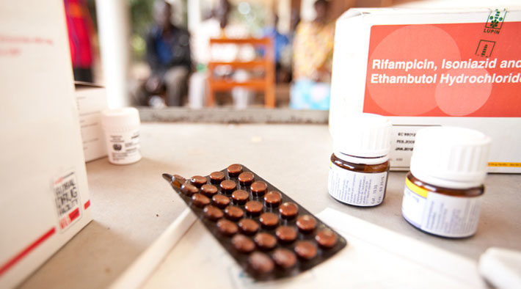
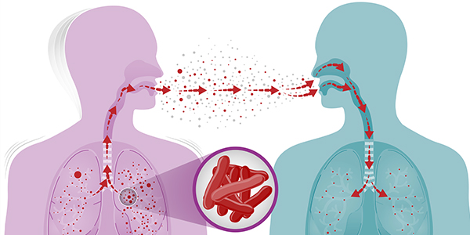
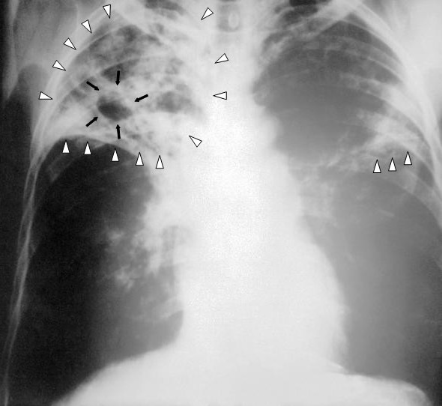
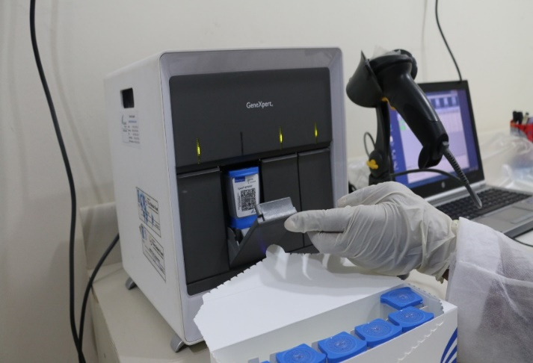
Thank you

