Slide 1
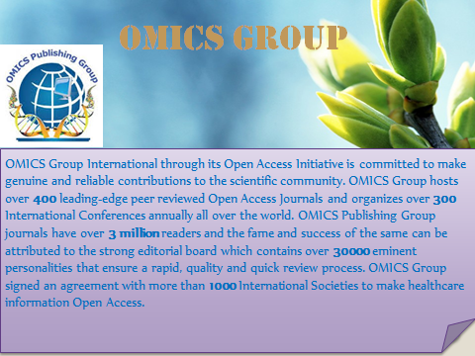

Slide 2
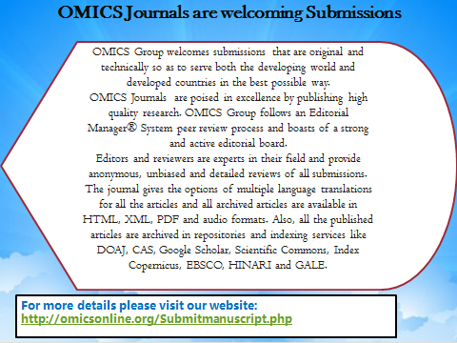

Slide 3
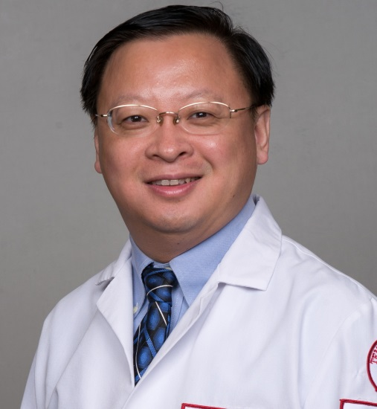

He Wang
Department of Pathology and Clinical Medicine
Temple University, USA
Journal of Clinical & Experimental Pathology

Slide 4
Biography

Slide 5
Research Interest
Cytopathology
Anatomic Pathology

Slide 6
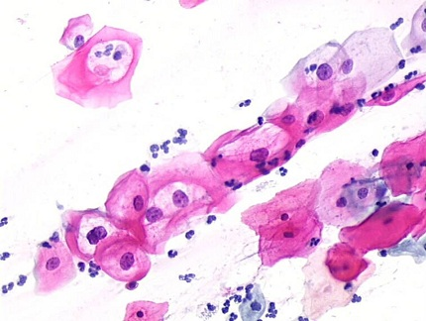
Cytopathology
Branch of pathology that studies and diagnoses diseases on the cellular level.
Common application of cytopathology is the Pap smear used to detect precancerous cervical lesions and prevent cervical cancer.

Slide 7
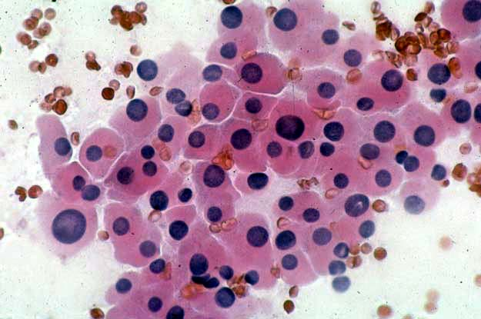
Cytopathology
Used to investigate thyroid lesions, diseases involving sterile body cavities (peritoneal, pleural, and cerebrospinal), and a wide range of other body sites, aid in the diagnosis of cancer.

Slide 8
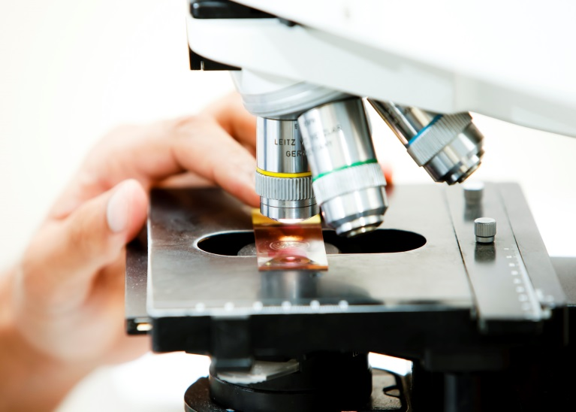
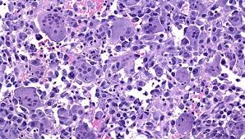
Anatomic Pathology
Branch of Pathology that deals with the diagnosis of disease based on the macroscopic, microscopic, biochemical, immunologic and molecular examination of organs and tissues.

Slide 9
Publications
Suo S, Lin N, Wang H, Zhang L, Wang R, et al. (2014) Intravoxel incoherent motion diffusion-weighted MR imaging of breast cancer at 3.0 tesla: Comparison of different curve-fitting methods. J Magn Reson Imaging .
Huang CH, Wang H, Pan JX, Zhou D, Chen W4, et al. (2014) Benzalkonium Chloride induces Subconjunctival Fibrosis through the COX-2- modulated activation of a TGF-Î²1/Smad3 Signaling Pathway. Invest Ophthalmol Vis Sci .
Wang DN, Ding WJ, Pan YZ, Tang KL, Wang T, et al. (2014) The Helicobacter pylori L-form: Formation and Isolation in the Human bile Cultures in vitro and in the Gallbladders of Patients with Biliary Diseases. Helicobacter .
Pusztaszeri M, Wang H, Cibas ES, Powers CN, Bongiovanni M, et al. (2014) Fine-needle aspiration biopsy of secondary neoplasms of the thyroid gland: A multi-institutional study of 62 cases. Cancer Cytopathol .
Liu QS, Luo XY, Jiang H, Xing Y, Yang MH, et al. (2014) Salvia miltiorrhiza injection restores apoptosis of fibroblast-like synoviocytes cultured with serum from patients with rheumatoid arthritis. Mol Med Rep.

Slide 10
